Slide 1

The State of the Network
Michael Horberg, MD MAS FACP FIDSA
HCSRN Governing Board Chair
Associate Medical Director
Kaiser Permanente Mid-Atlantic Permanente Medical Group
Executive Director,
Mid-Atlantic Permanente Research Institute

Slide 2
Mission, Vision & Values
Mission:
To improve individual and population health through research that connects the resources and capabilities of learning health care systems.
Vision:
The Health Care Systems Research Network is the nation’s preeminent source of population-based research that measurably improves health and healthcare for all.
Values:
Scientific Excellence, Innovation and Creativity, Actionable Research Findings, Collaboration and Teamwork, Transparency, Efficiency
HCSRN Brings Together:
  Research centers from many of the nation’s best and most innovative health care systems
  20 member organizations (including 1 in Israel)
  Representing more than 2,000 scientists and research staff

Slide 3
Who We Are / Our Membership
HealthPartners Institute HealthPartners – Minneapolis, MN
Marshfield Clinic Research Institute - Marshfield Clinic Health System - Marshfield, WI
Meyers Health Care Institute, UMass Medical School - Fallon Community Health Plan; Reliant Medical Group
Worcester, MA
KP Washington Health Research Institute – Kaiser Permanente Washington
Seattle, WA
Essentia Institute of Rural Health - Essentia Health
Duluth, MN
Institute for Health Research Kaiser Permanente Colorado
Denver, CO
Center for Health Services Research; Public Health Sciences - Henry Ford Health System
Detroit, MI
Center for Health Research - Kaiser Permanente Northwest
Portland, OR
Harvard Pilgrim Health Care Institute, Dept. of Population Medicine Harvard Medical School
Boston, MA
Advocate Aurora Research Institute Advocate Aurora Health
Chicago, IL and Milwaukee, WI
Division of Research Kaiser Permanente
Northern California
Oakland, CA
Geisinger Research Geisinger Health
Danville, PA
Center for Health Systems Research Sutter Health
Palo Alto, CA
Mid-Atlantic Permanente Research Institute - Kaiser Permanente Mid-Atlantic States
Rockville, MD
Department of Research & Evaluation Kaiser Permanente
Southern California
Pasadena, CA
Center for Outcomes Research & Evaluation Kaiser Permanente Georgia
Atlanta, GA
Division of Research Baylor Scott & White Temple, TX
Institute for Health Services Research Maccabi
Health
Services Care
Tel Aviv Israel
SLU – SSM Health
St. Louis, MO
Center for Integrated Health Research Kaiser Permanente Hawai’i
Honolulu, HI

Slide 4
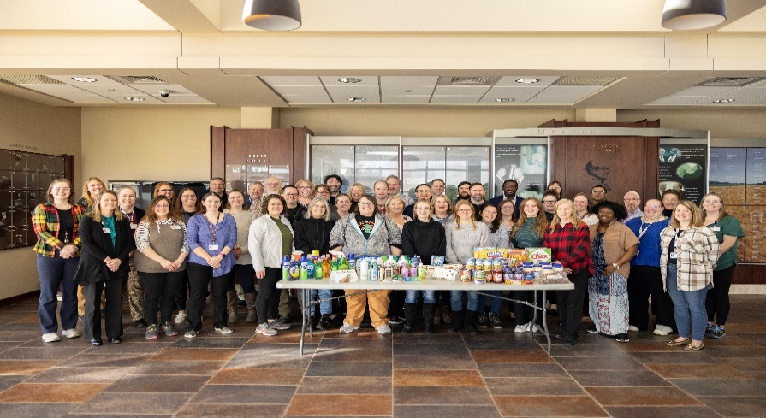
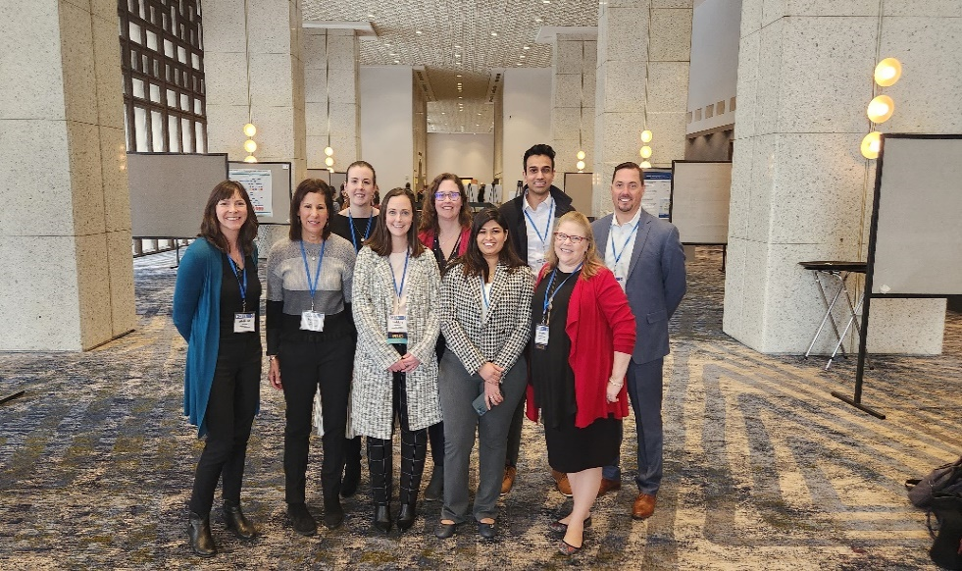
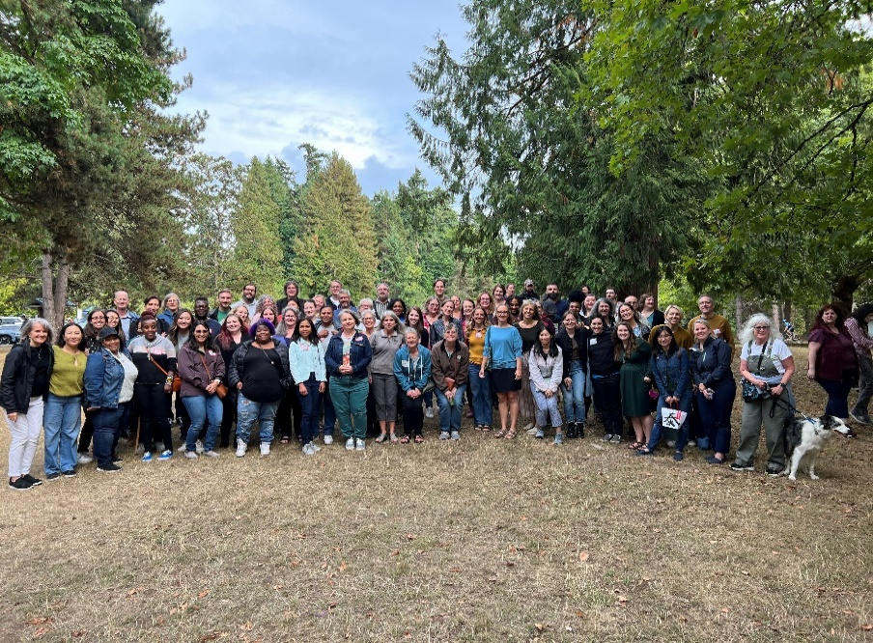
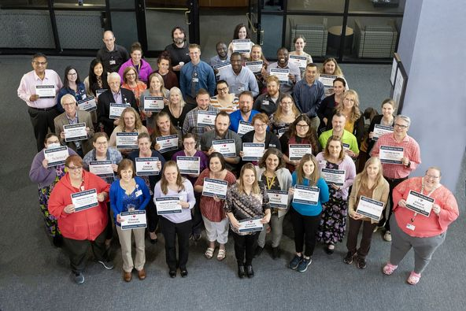

Who We Are - Please Send Us Your Group’s Photos!
Marshfield
Geisinger
KP Washington Research Institute
KPMAS MAPRI

Slide 5
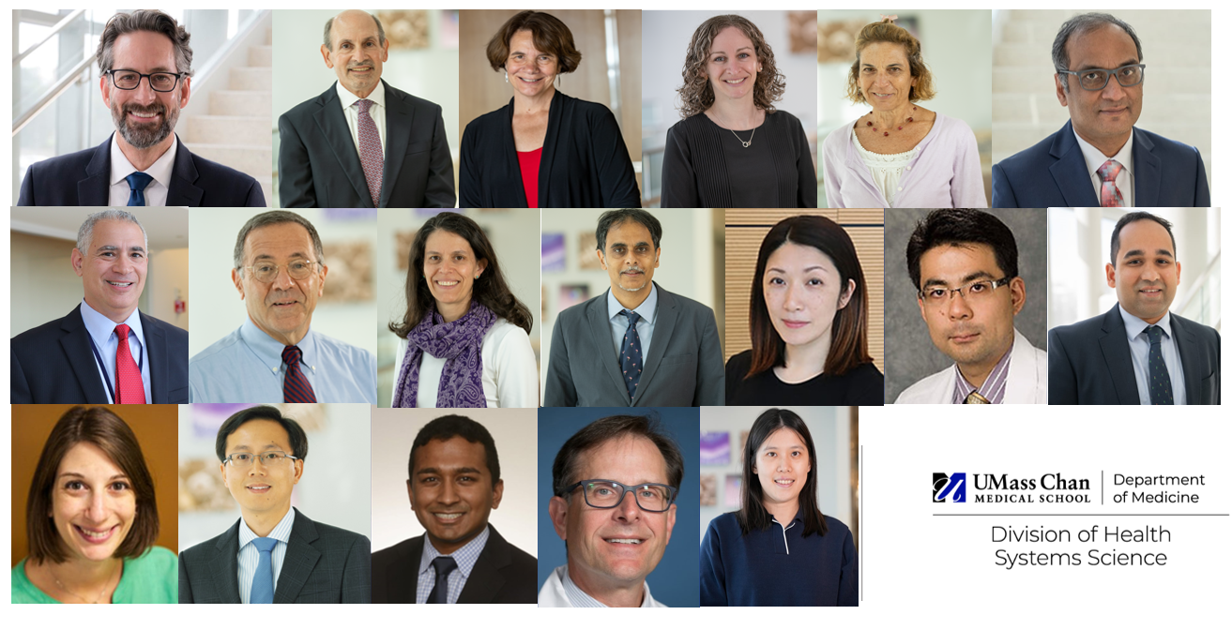
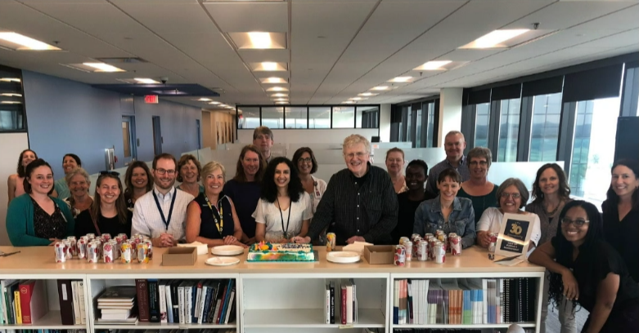
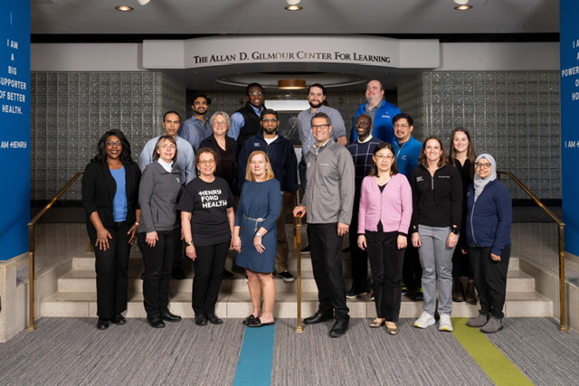
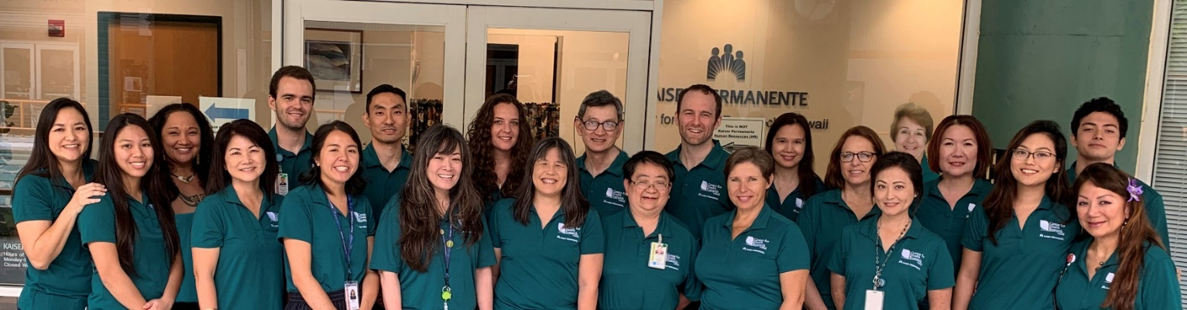
Who We Are - Please Send Us Your Group’s Photos!
UMass Chan
Health Partners
Henry Ford
CIHR—KP Hawai’i

Slide 6
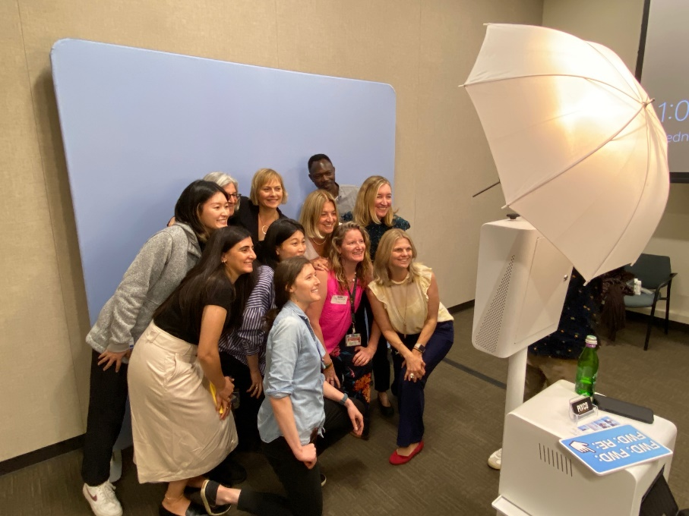

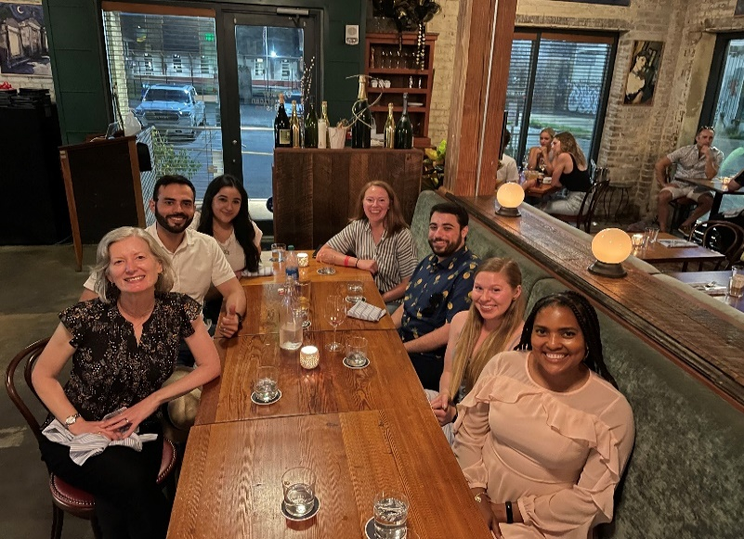
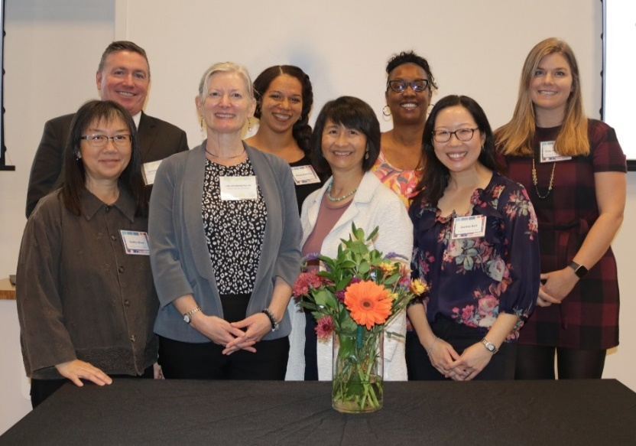
Who We Are - Please Send Us Your Group’s Photos!
KPNC Division of Research
Harvard Pilgrim Health Care Institute

Slide 7

Our Central Office!
Fantastic Partners!

Slide 8
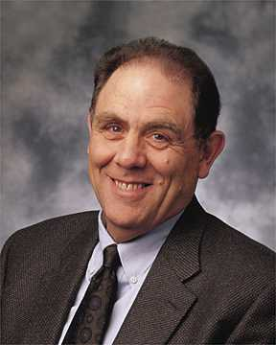
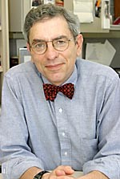
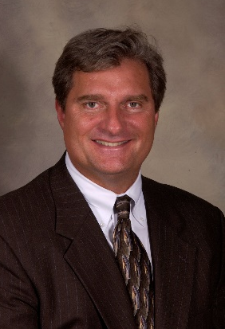

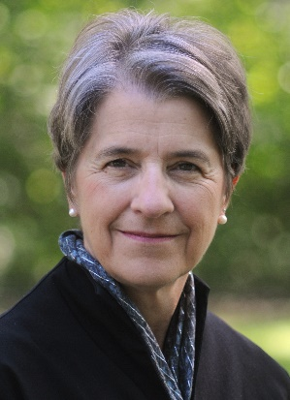
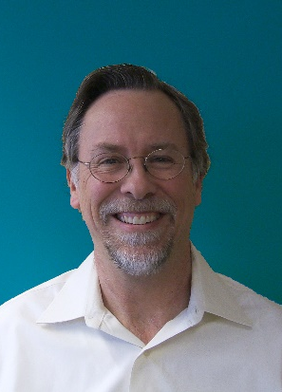
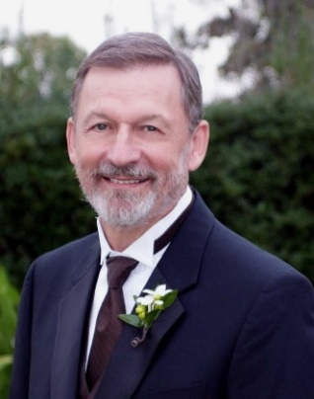
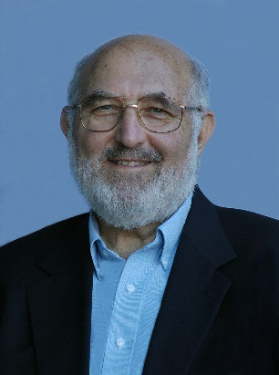
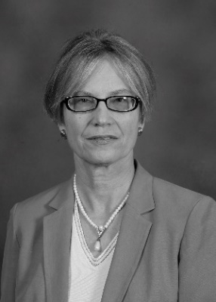
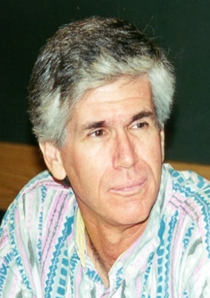
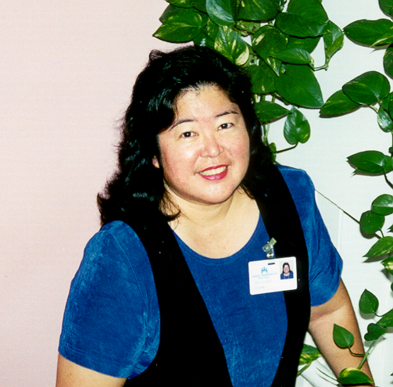
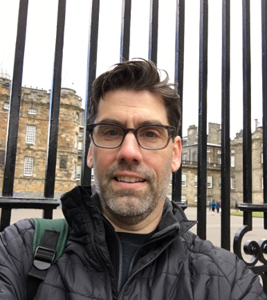
We Stand on the Shoulders of Giants and Visionaries!
Our Giants & Visionaries
Original Board members (10 sites)
VSD began in 1990
HMORN founded in 1994
  Named HCSRN in 2015
CRN started up in 1998
First Executive Director hired 2015
Ed Wagner, MD MPH Group Health
Rich Platt, MD, MSc
Harvard Pilgrim
Andy Nelson, MPH
HealthPartners
Joe Selby, MD MPH
KP Northern California
Nancy Whitelaw, PhD
Henry Ford
Arne Beck, PhD
KP Colorado
Dennis Tolsma, MPH
KP Georgia
Mitch Greenlick, PhD
KP Northwest
Diana Petitti, MD
KP Southern California
Marc Rosen, MD MPH
KP Hawaii
Joyce Gilbert, MPH
KP Hawaii
Robert Greenlee, PhD MPH
Marshfield Clinic Health System

Slide 9
What We Gain by Being Together!
The HCSRN meets annually to achieve the following objectives:
Stimulating collaborative research between researchers of our member sites
  Especially multi-site collaborative research via forums for researchers with common interests
  Either by subject matter or methodologies
Advance our individual and collective research efforts
Disseminate research findings and discuss methodologic issues from studies across multiple health care systems
Promote collaboration and scientific rigor in health sciences and health services research
To contribute to the national and international research agenda and identify areas in which the HCSRN is uniquely positioned

Slide 10
Why I Want to be Here
Engage in great science
  Learn and share new data, new methods, and new findings
Meet old and new colleagues
  Make connections - I challenge all of us to make 2-3 new friends/colleagues while here
Bring back new ideas to MAPRI and KPMAS
  I always come back with 2-3 new ideas
Further enhance and develop HCSRN
Enjoy each other’s company

Slide 11
HCSRN Celebrates 30 Years!
30th Anniversary Recognition—this is our 30th year (2024-2025)!
  New Logo
  Merchandise
    Go to: https://shop.printyourcause.com/campaigns/30th-anniversary-store
  Videos
  Celebratory Reception
  Timeline
  Photobooth
  Founders Award

Slide 12
Founders’ Award
Inaugural award to be presented in 2025 at the 30th Annual Conference
Awardees should exemplify the:
  Vision and confidence to create something new or unique in embedded healthcare research;
  Spirit of fostering collegiality and collaboration across partner organizations, which remains among the most important values of the network;
  Persuasive expertise and determination to create a legacy of funded platforms or other valuable resources for conducting productive research in the HCSRN
Nominating process and application to be announced soon!

Slide 13
Our Strengths (Lest We Forget!)
Our tradition of collaboration among like minded researchers
Common ethos
Common data models
  Even as we further develop our data
Support for each other
  Working to help develop the research careers of new investigators and research teams
Our data
  We represent over 20 million lives US and Israel!

Slide 14
2023 Accomplishments
  501(c)3 IRS Designation Received (retro to 2022) - this permits us to expand our business
  More formal budget development
  Engaged and committed leaders
  Financial Policies Creation
    Helps us be more deliberate in our spending and budgeting processes
  Member Clicks—improving our membership database
  Enhanced Communications
  Annual Conference Planning and Implementation
  Transition to SharePoint and Teams
  Strategic Plan 2024-2026
  Engagement → Increasing Value for participation
  Collaboration → Increasing Funded opportunities
  Sustainability → Organizational Transformation and Increasing Value Proposition for our member institutions
  VDW operations → Working group leads and new data development

Slide 15
2023 Accomplishments (Continued)
  Effective Committee Structure to Meet Board Needs
  Executive
  Finance
  DEI
  Annual Conference
  Task Forces
  HCSRN Messaging Task Force
  Web Site Content Review
  Path Forward
  Value Task Force
  We Encourage You to Get Involved!

Slide 16
Our Value Task Force - Big Work in 2023!
What is the Value Task Force?
  In February 2023, the Value Task Force was created with the explicit purpose of identifying and prioritizing ways to enhance the value of HCSRN membership for all constituencies.
  Data gathering included:
  Task Force Meetings
  Surveys
  Conversations with HCSRN investigators and staff
  Review of published manuscripts
  Review of HCSRN Board reports and documents related to past strategic and value discussions

Slide 17
2023 Accomplishments
The Result:
  Consensus formation of Task Force recommendations
  Final Report presented to the Governing Board in December 2023
  Special Thanks to Task Force Members:
  Eric Wright, Geisinger
  Teaniese L Davis, KP Georgia
  Denise Angst, Advocate Aurora
  Leslie Hinyard, SLU
  J.B. Jones, Sutter
  Kathleen Mazor, UMass Chan
  Central Office Support: Suzanne Simons, Mike Breslin, Alex Grandin

Slide 18
2023 Accomplishments
VALUE TASK FORCE RECOMMENDATIONS
Recommendations
Develop and implement a mechanism for tracking collaboration across HCSRN institutions This is mission critical for us to added value efforts
Develop a plan to increase HCSRN value visibility both internally (first) and externally (second) Creating and demonstrating added value is critical for membership retention and eventually growth.
NOTE: A lot will be happening concurrently, but we will need to navigate through limited resources and budget constraints.

Slide 19
2023 Accomplishments
VALUE TASK FORCE RECOMMENDATIONS
Recommendations
Develop a long-term plan for HCSRN membership growth, including determining when and how growth would start and develop.
Develop a financial plan that includes supplementing member site dues and annual meeting registration with other funding sources. Sadly, no money no mission no matter how impactful the mission is.

Slide 20
2023 Accomplishments
VALUE TASK FORCE RECOMMENDATIONS
Recommendations
Continue ongoing evaluation of the HCRN’s value to inform priorities and optimize membership retention and growth. This is a primary responsibility of your HCSRN Governing Board
Develop guidance and optimize HCSRN Special Interest Groups (SIGs) as vehicles to foster inter-site collaborations. We want to get you all involved! From diverse and multi-institute collaborations comes improved research and research dollars!

Slide 21
2023 Accomplishments
VALUE TASK FORCE RECOMMENDATIONS
Recommendations
Charge the Virtual Data Warehouse (VDW) Implementation Group (VIG) to identify opportunities to improve efficiencies and modernize the VDW. This is a recognized and ongoing priority.
Develop a concrete plan to strategically invest HCSRN monies in initiatives that foster the growth of existing, or development of new, funded collaborations. We thank in advance the finance committee and governing board for their work on this important opportunities.

Slide 22
2023 Accomplishments
VALUE TASK FORCE RECOMMENDATIONS
Recommendations
Develop a process to ensure diversity, equity and inclusion within all HCSRN activities. This is ongoing but needs constant attention. Please get involved with the EID Committee (best contact - Tina Davis, PhD [KPGA])
Develop a hub of centralized mentorship structures, which have historically been housed within SIGs or subsidiary research networks. This can help our more junior investigators and enhances opportunities for our more senior investigators.
Our next steps are to put these into motion with our Path Forward Task Force and assiduous work of the board, our staff, and your engagement!

Slide 23
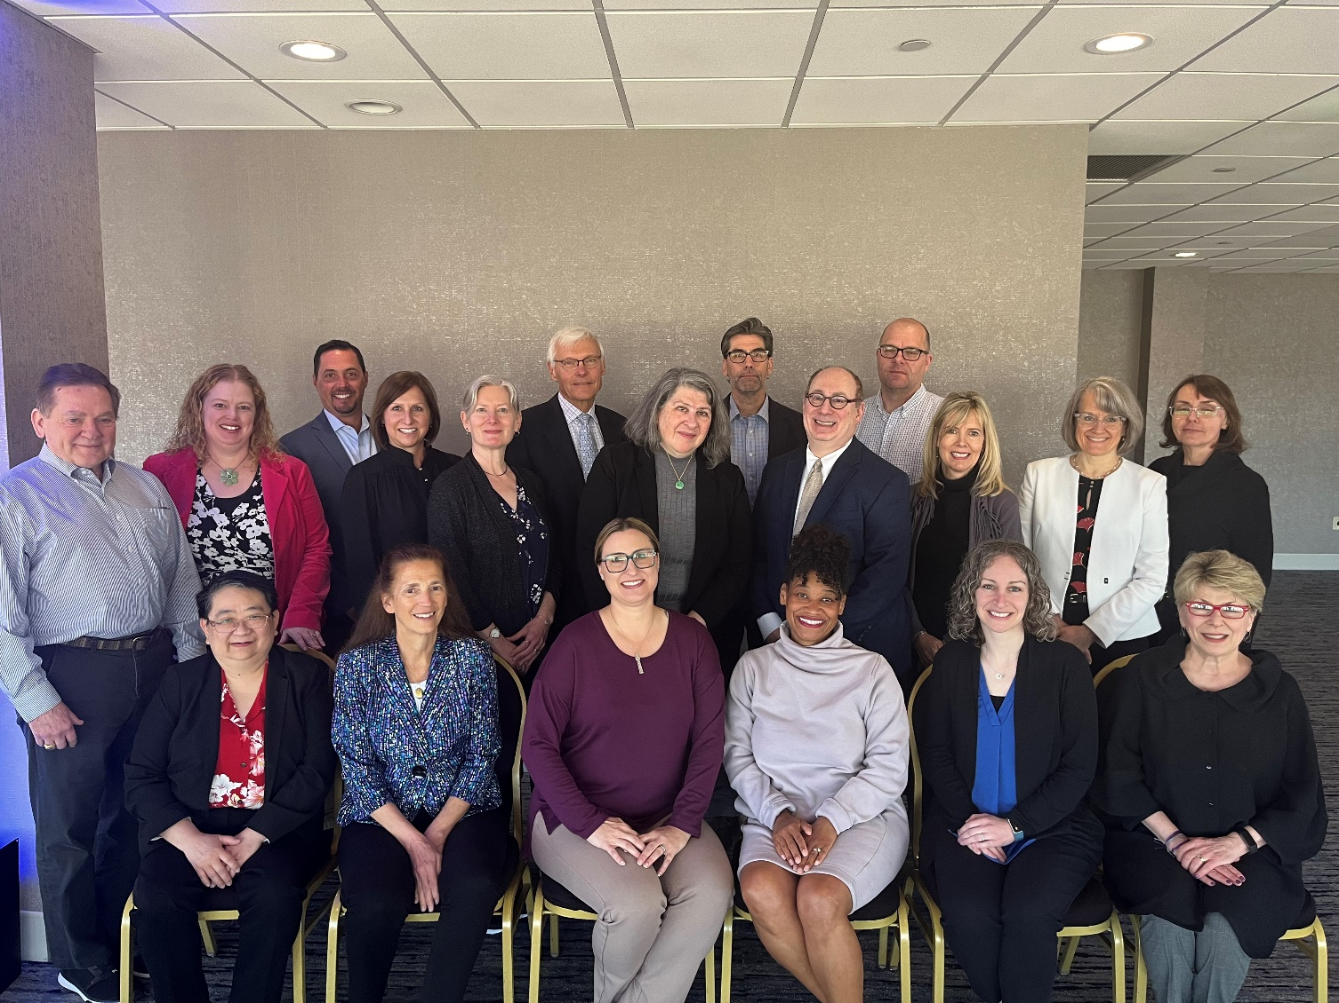
Your HCSRN Governing Board
Our Duties:
  Stewardship of network assets
  Operational leadership
  Financial oversight and resource planning
  Strategic direction and implementation
  Positioning network for success with members, funders, external partners, etc.
Key Agenda Topics this Meeting:
  Value Task Force Recommendations
  Strategic Planning
  Organizational Financials
  VDW Operations and Needs
  30th Anniversary Celebration Task Force Update

Slide 24
2023 Executive Committee
Chair | Michael Horberg | 2023-2024
Chair-Elect | Rebecca Rossom | 2023-2024
Secretary | Teaniese (Tina) Davis | 2024-2025
Treasurer | Leslie Hinyard | 2024-2025
Immediate Past Chair | Robert (Bob) Greenlee | 2023-2024

Slide 25
2024 Governing Board
Denise B. Angst, PhD, RN | Vice President, Academic Research and Strategic Partnerships | Advocate Aurora
Alan Bauck, MBA | Director, Research Data and Analytics Center | Kaiser Permanente Center for Health Research
Sivan Gazit, MD | Maccabi Institute for Health Services Research | Maccabi Healthcare Services
Tina Davis, PhD | Executive Director, Center for Research and Evaluation | Kaiser Permanente Georgia
Robert T. Greenlee, PhD, MPH | Research Scientist, Marshfield Clinic Research Foundation | Marshfield Clinic Health System
Leslie Hinyard, PhD, MSW | Director, St. Louis University AHEAD Institute | St. Louis University / SSM Health
Stacey Honda, MD, PhD | Medical Director, Center for Integrated Healthcare Research | Kaiser Permanente Hawaii
Michael A. Horberg, MD, MAS | Executive Director, Mid-Atlantic Permanente Research Institute | Kaiser Permanente Mid-Atlantic Permanente Medical Group
J.B. Jones, PhD, MBA | Principal Investigator, Sutter Health Center for Health Systems Research | Sutter Health
Rita Mangione-Smith, MD, MPH | Executive Director, KP Washington Health Research Institute | Kaiser Permanente Washington

Slide 26
2024 Governing Board
Mara Epstein | Associate Professor, Division of Health Systems Science UMass Chan Medical School | Division of Health Systems Science
Kristi Reynolds, PhD, MPH | Assistant Director for Epidemiology, Department of Research & Evaluation | Kaiser Permanente Southern California
Christine Neslund-Dudas, PhD | Associate Research Scientist, Henry Ford Health System Research | Henry Ford Health System
Rebecca C. Rossom, MD, MS | Senior Investigator, Research, HealthPartners Institute | HealthPartners
Katherine Sanchez, PhD, LCSW | Director, Diversity and Inclusiveness in Research | Baylor Scott & White Health
Julie A. Schmittdiel, PhD, MA | Associate Director for Health Care Delivery and Policy, Kaiser Permanente Division of Research | Kaiser Permanente Northern California
Claudia Steiner, MD, MPH | Executive Director, Institute for Health Research | Kaiser Permanente Colorado
Darren Toh, ScD | Professor of Population Medicine, Population Medicine, Harvard Medical School | Harvard Pilgrim Health Care
Stephen C. Waring, DVM, PhD | Senior Research Scientist, Essentia Institute of Rural Health | Essentia Health
Eric Wright, PharmD, MPH | Professor and Director, Center for Pharmacy Innovation and Outcomes | Geisinger

Slide 27
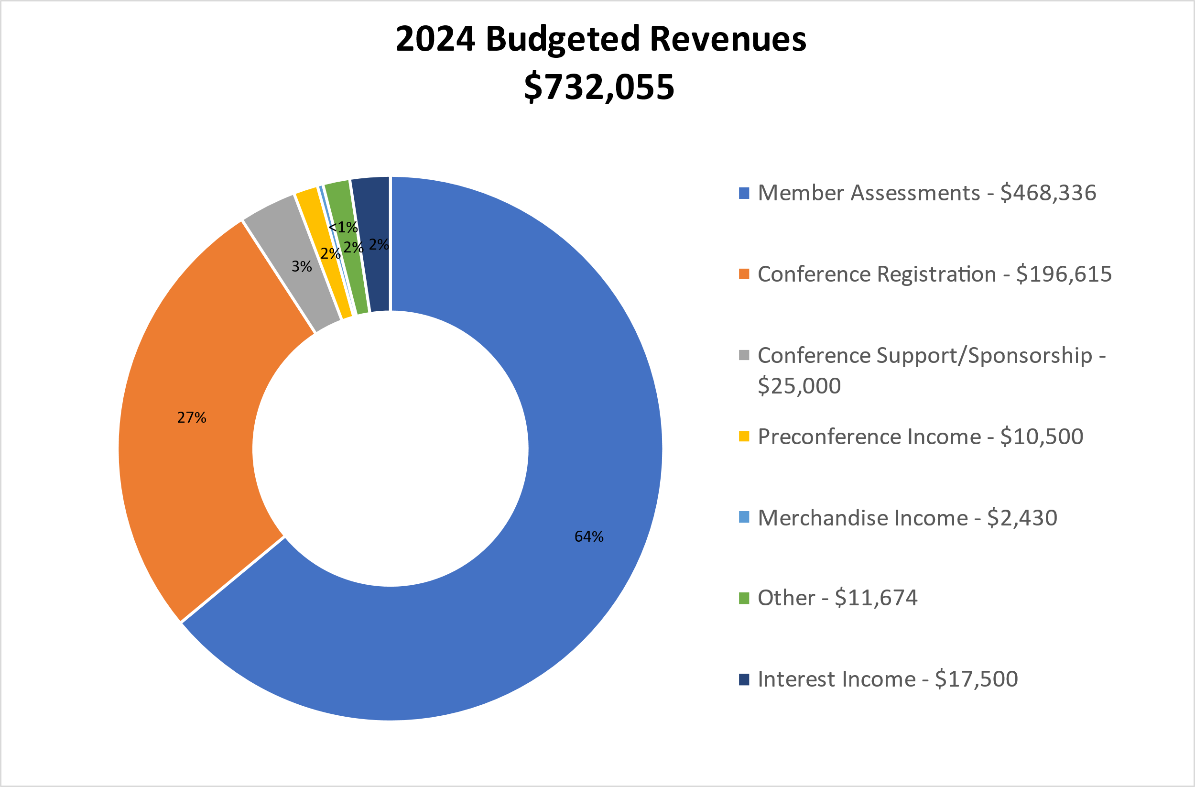
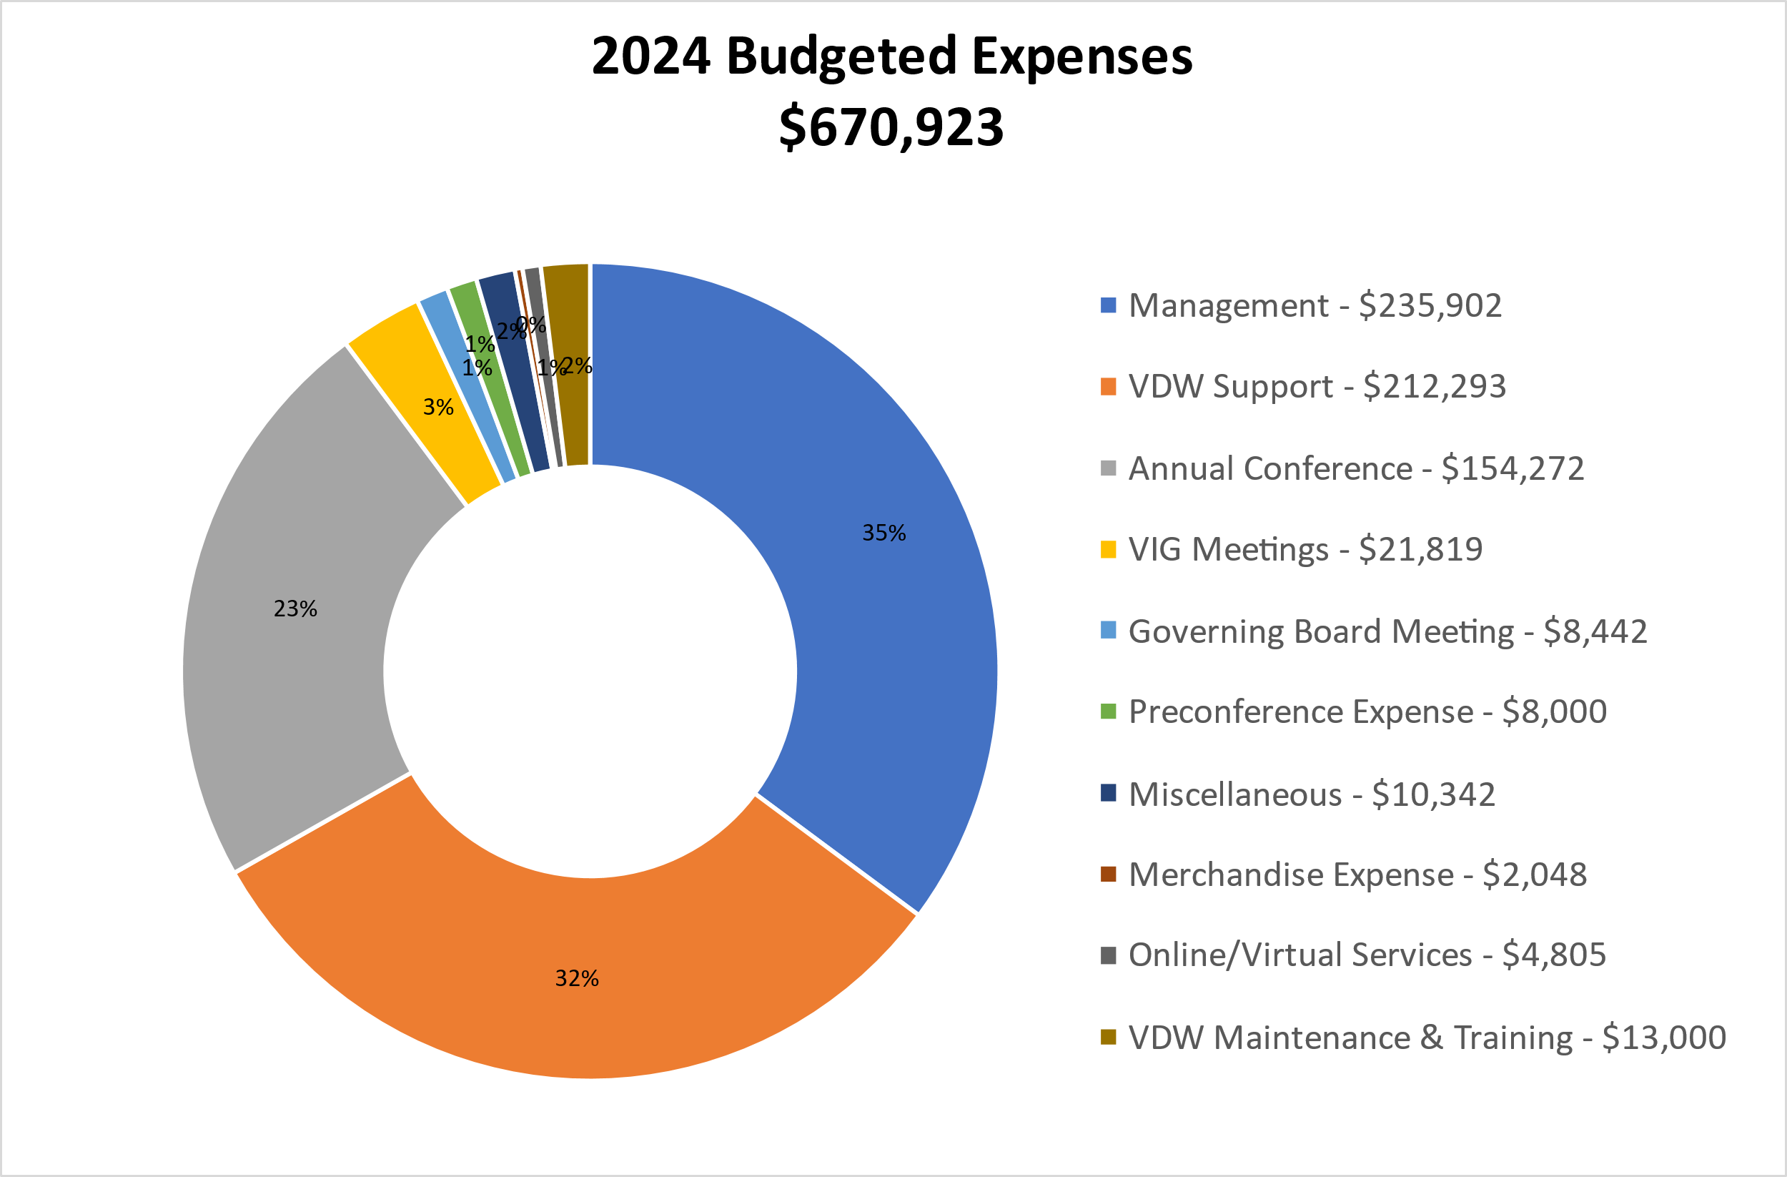
2024 Budget
We are within budget and looking at how to spend our funds to fulfill our mission and our path forward priorities.

Slide 28
Overview – HCSRN VDW
The Virtual Data Warehouse (VDW) is the HCSRN’s method for standardizing and pooling electronic health data for multicenter research
  The HCSRN VDW is a common approach, not a central database
  Member sites agree on data to make available for research, and on definitions and standard formats to apply
  Raw administrative, clinical and claims data are transformed to the agreed upon set of agreed upon data standards at every HCSRN site
  Each institution’s VDW data remain at their site until a study-specific need arises
  The required study data are extracted after contractual, IRB, and HIPAA requirements are met
  The Governing Board has instructed the VDW to pursue development of SDOH table(s)
New this year!:
Stacey Honda, MD PhD (KPHI) as VIG Board Liaison
Special thanks to Mark Jurkovich, DDS, Yonah Karp, Celeste Machen, Jenny Staab, PhD and Rick Krajenta.
Please acknowledge and thank our Working Group leaders!

Slide 29


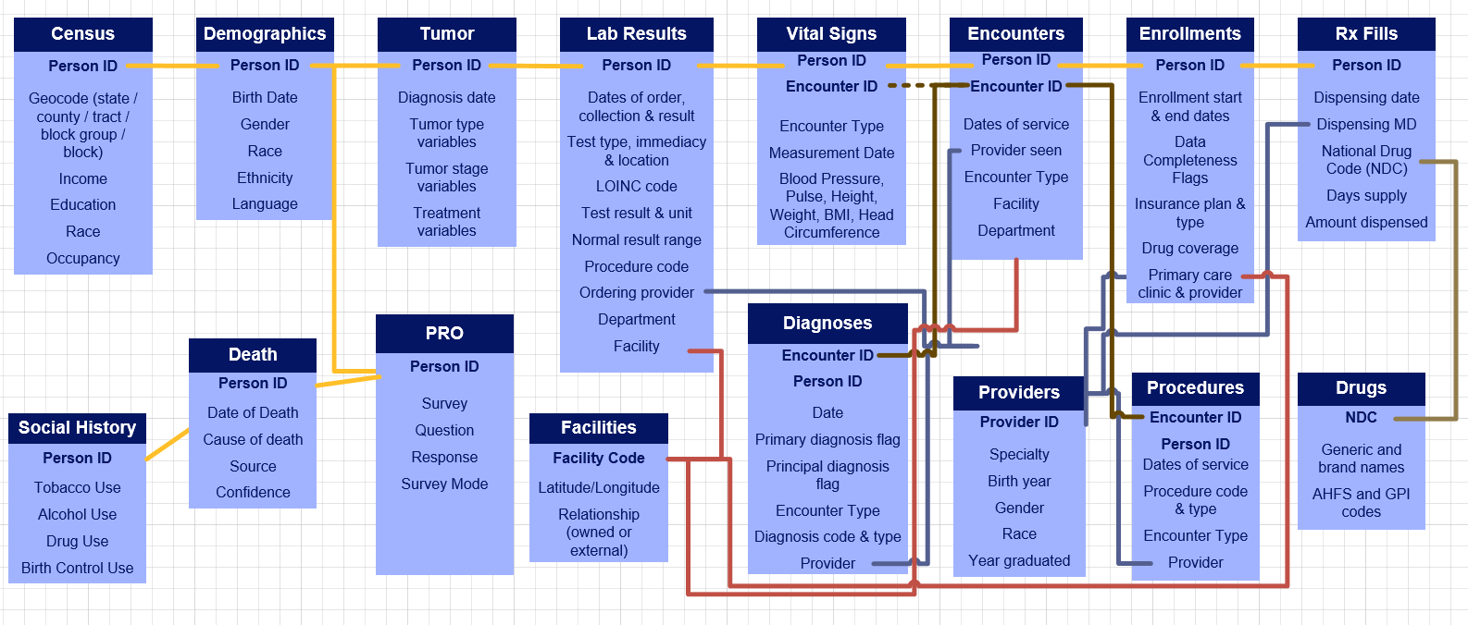
VDW Usage: Core VDW Tables
Notes:
Hypodermics are data areas that generally only a provider would have, and the piggy bank is the data area that only an insurer would have (typically).
Note that not every site implements every data area. Tumor, in particular, is one that several sites do not have.

Slide 30
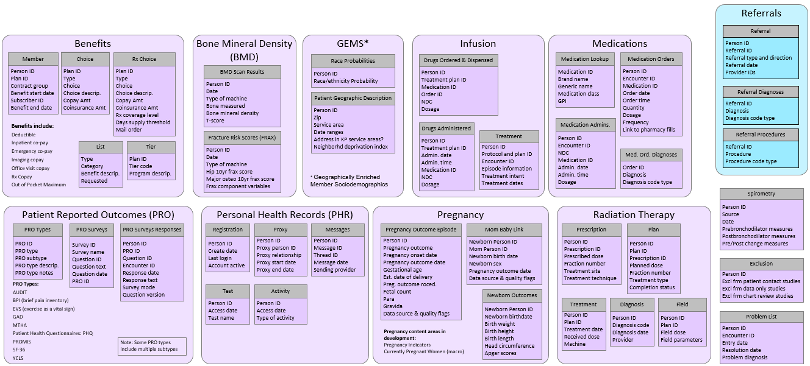
The “Expanded CESR Universe” (KP Only)
Notes:
CESR Is important for many reasons – but the one I want to highlight is that their work gives us many great shoulders to stand on! Recent example – PRO. And we’ll be talking about this later – CESR SDoH is a good place for us to start.

Slide 31
2024 Annual Conference Planning Committee
A HUGE THANKS TO ALL!
Notes:
Note appreciation for speed with which we had to put this together.
Remind folks this was not our originally intended dates.
Incredible amount of speed required.
Had to expediate abstract submission deadlines
Expedited slide deadlines, etc.
We are much more ahead already for next year!

Slide 32
Thank You Volunteers!
Michael Miller
Glen Buth
Eric Wright
Diana Kleber
Apoorva Pradhan
Veronica Fitzpatrick
Alice Pressman
Suzanne Gillespie
Iridian Guzman
Stephanie Hooker
Rita Mangione-Smith
Jana Hirschtick
Karen Coleman
Musu Sesay
Sam Savitz
Cheryl Lefaiver
Michelle Jurado
Diana Kleber
Elisabeth DeMarco
Esmeralda Campos
Lisa Pieper
Michelle Simpson

Slide 33
Thank You Volunteers!
John Brill
Marybeth Ingle
Nicole Glowacki
Leslie Hinyard
Ramona Donovan
Andy Marek
JB Jones
Maureen Shields
Rasha Khatib

Slide 34

Thank You For Your Support
  List with Logos

Slide 35
We’ll See You Next Year…
2025 Annual Conference in St. Louis!

Slide 36
Thanks for Your Attention
  Next:
  Q&A/Discussion
  Annual Award Presentations

Slide 37
2024 Awards
Presentation

Slide 38
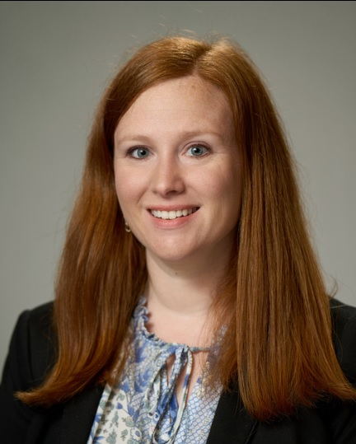
Paper of the Year
Lisa R. Miller - Matero, PhD, ABPP
Associate Scientist, Associate Director, Health Services Research Director, Psychology Internship Program Director, Health Psychology Fellowship Program
Henry Ford Health Systems
Suicide Attempts After Bariatric Surgery: Comparison to A Nonsurgical Cohort Of Individuals With Severe Obesity
Surgery for Obesity and Related Diseases (2023) 1-9
Nominated By:
Melissa Harry
Essentia Health

Slide 39
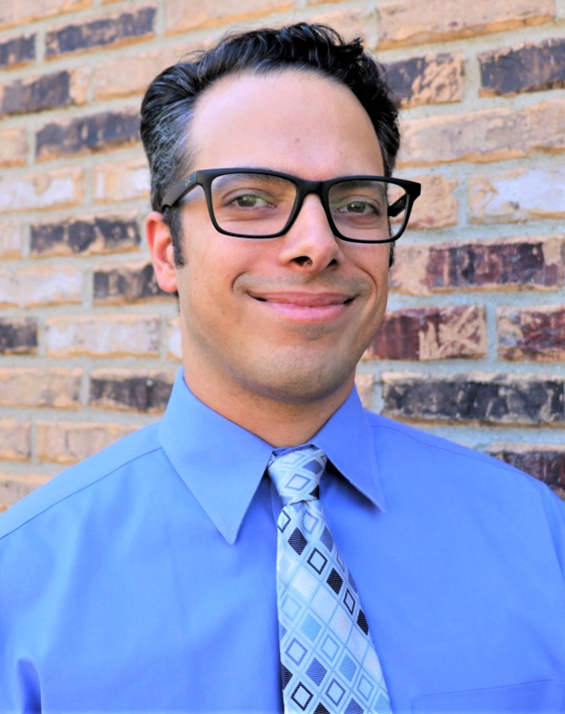
Mentor of the Year
Jordan Braciszewski, PhD
Associate Scientist and Associate Director for Training and Education
Center for Health Policy & Health Services Research
Henry Ford Health Systems
Nominated By:
Brian Ahmedani
Elyse Lamoca
Amy Loree
Geoffrey Kahn
Lisa Matero
Henry Ford Health System
Brianna Costales
Robert Penfold
Greg Simon
Stacy Sterling
Kaiser Permanente
Rebecca Rossom
Health Partners

Slide 40
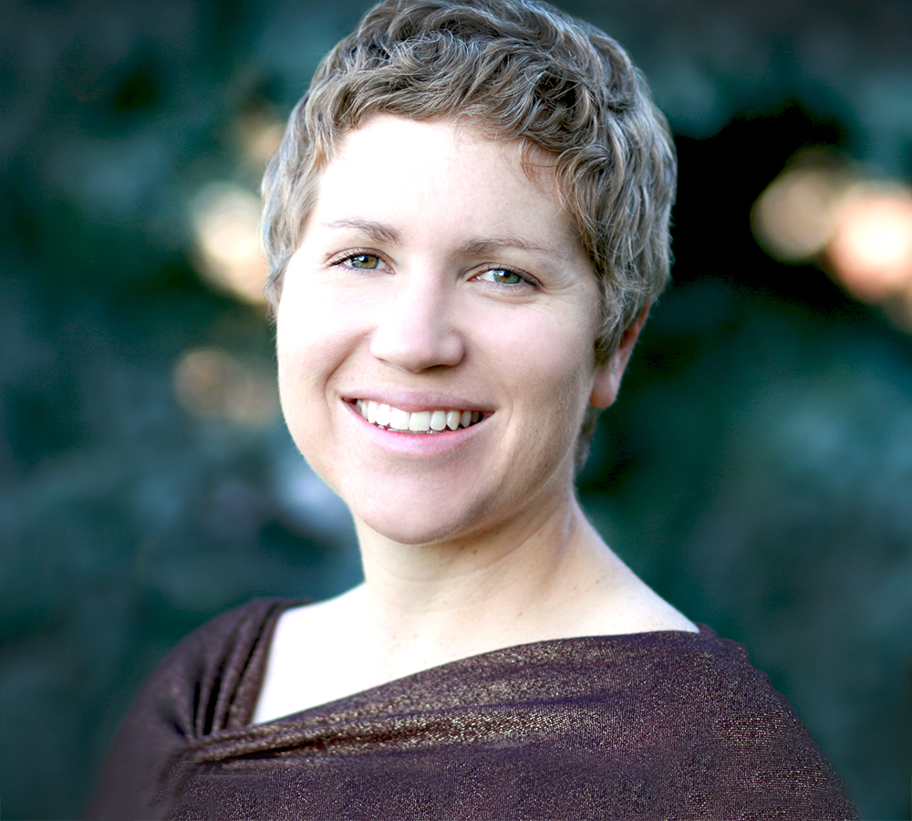
Investigator of the Year
Jennifer M. Boggs, PhD, MSW
Investigator
Institute for Health Research
Kaiser Permanente Colorado
Results from a Hybrid Effectiveness-Implementation Trial to Improve Uptake of a Secure Firearm Storage Program in Pediatric Primary Care

