Slide 1
Welcome to the
2024 Health Care Systems Research Network Conference
April 9-11, 2024
Milwaukee, WI

Slide 2
Advancing High Quality , Equitable Research in the Age of New Health Care Technologies
Health Care Systems Research Network
Milwaukee, Wisconsin
April 9-11, 2024
Nathan Stinson, Jr., PhD, MD, MPH
Division Director, Community Health and Population Science
National Institute on Minority Health and Health Disparities, NIH

Slide 3
NIMHD Mission
The mission of NIMHD is to lead scientific research to improve minority health and eliminate health disparities.
To accomplish this, NIMHD:
  Plans, reviews, coordinates, and evaluates all minority health and health disparities research and activities of the National Institutes of Health
  Conducts and supports research in minority health and health disparities
  Promotes and supports the training of a diverse research workforce
  Translates and disseminates research information
  Fosters innovative collaborations and partnerships

Slide 4
Minority Health Definition
Minority Health - Distinctive health characteristics and attributes of the minority racial and/or ethnic groups in the U.S.
Minority Health Populations- OMB categories
Black or African American
Asian
American Indian or Alaska Native
Native Hawaiian or Other Pacific Islander
Latino or Hispanic
Middle Eastern or North African

Slide 5
Health Disparities Definition
Health Disparity - A health disparity is defined as a health difference that adversely affects disadvantaged populations, based on one or more of the health outcomes.
NIH-designated populations with health disparities include racial/ethnic minorities, low SES, sexual and gender minorities, underserved rural populations, and individuals with disabilities.

Slide 6




Mechanisms Leading to Health Disparities
Individual Behaviors, Lifestyle, Beliefs and Attitudes: racism, childhood adverse conditions, food insecurity, witness to or victim of violence, immigrant, limited English proficiency, response to chronic stress
Biological Processes and Genetics: earlier age of onset, gene variants, metabolic differences, susceptibility, faster progression or greater severity, brain networks, microbiome, extracellular RNA, sleep
Physical and Cultural Environment: place, social system, neighborhood, infrastructure, family, social interactions, network, community cohesion
Clinical Events and Health Care: differential treatments, poor communication, adverse events to medications, falls, progression of disease, access, use/abuse of appropriate services, end of life care

Slide 7
NIMHD Extramural Research Interest Areas
Clinical and Health Services Research
Integrative Biological and Behavioral Sciences
Community Health and Population Sciences

Slide 8
Clinical and Health Services Research
Clinical Research and Treatment Interventions
Health promotion
Patient-Health Care System Interactions
Epidemiology of Health Care Utilization and Outcomes
System-Level Health Services Research
Health care system organization
Health care models
Health care policy
Health Care Delivery in non-Clinical Settings
Community-based behavioral settings
Home-based care
School-based health centers
Evidence-based guidelines
Implementation
Implicit and explicit bias
Patient active participation and agency
Patient-clinician relationship
Patterns of Utilization
Natural Experiments
Access

Slide 9
Integrative Biological and Behavioral Sciences
Biological, Physiological, and Developmental Mechanisms
Social Epigenomics
Psychological, Behavioral, and Social Mechanisms
Environmental Factors
Development, Testing, and Delivery of Interventions
Biobehavioral or Other Integrative Interventions
Dissemination and Implementation Science
Data Science, Statistical Models, and Technology
Stress on Physiological Functioning
Affective Science
Intra- and Interpersonal Thought Processes
Genomic and Epigenomic Factors
Biobehavioral
Climate Change
Exposome
Social and Built Environment
Resilience
Chemical and Physical Agents and Other Hazardous Factors

Slide 10




Community Health and Population Science Research
Epidemiology
Pathways and Determinants of Population Health
Pathways and Determinants of Community Health
Community-based Prevention and Health Promotion Interventions
Community-derived interventions
Dissemination and implementation research
Epidemiological research with understudied populations
Pathways and mechanisms of macro-level health determinants on population health
Place-based, sociocultural, and organizational influences on health
Epidemiology of emerging health behaviors or health conditions

Slide 11
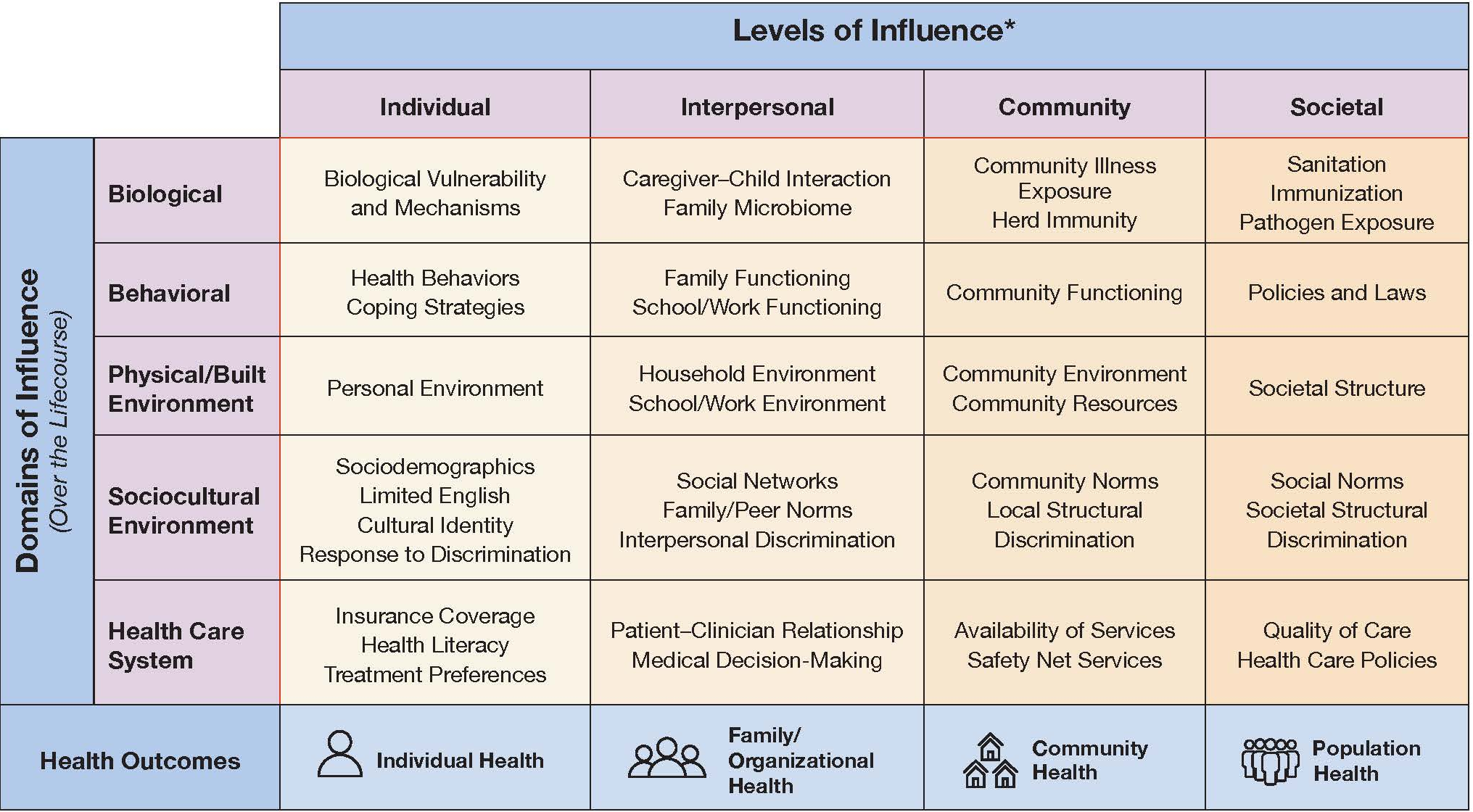
NIMHD Research Framework
Link to NIMHD Minority Health and Health Disparities Research Framework web page

Slide 12

Special Issue of AJPH: New Perspectives to Advance Minority Health and Health Disparities Research
Supplement 1, 2019, Vol 109, No S1
Sideways Progress in Intervention Research Is Not Sufficient to Eliminate Health Disparities
Jennifer Alvidrez PhD, and Nathan Stinson Jr MD, PhD, MPH
Accepted: December 26, 2018
Published Online: January 30, 2019

Slide 13
NIH Peer Review of Applications

Slide 14
Peer Review Meeting - Expertise
The NIH Scientific Review Officer (SRO) assembles a team of peers with appropriate scientific expertise for the panel. Potential reviewers are identified based on their expertise, review experience, grant history, and program staff recommendations.
Diverse opinion through representation for gender, race/ethnicity and geography are needed.
The SRO ensures that any conflicts of interest (real or apparent) that may compromise the review are identified and managed appropriately.

Slide 15
Peer Review Meeting - Scoring
IMPACT is the likelihood of an application to exert a sustained, powerful influence on the research field(s) involved, in consideration of all review criteria as specified in the NOFO.
The assessment of IMPACT is given as an integer with a score range from 1 (best possible score) to 9 (worst possible score).
All reviewers (not in conflict) at the meeting assign a score for each application that is discussed (usually the “upper half”).
Applications that are determined by the panel to be non-competitive (generally the lower half) receive a rating of “Not Discussed”.
Notes:
How is an application scored in the review meeting?

Slide 16
Score Descriptors for Overall Impact Score
Impact | Score | Description | Additional Guidance on Strengths/Weaknesses
High Impact | 1 | Exceptional | Exceptionally strong with essentially no weaknesses
 | 2 | Outstanding | Extremely strong with negligible weaknesses
 | 3 | Excellent | Very strong with only some minor weaknesses
Medium Impact | 4 | Very Good | Strong but with numerous minor weaknesses
 | 5 | Good | Strong but with at least one moderate weakness
 | 6 | Satisfactory | Some strengths but also some moderate weaknesses
Low Impact | 7 | Fair | Some strengths but with at least one major weakness
 | 8 | Marginal | A few strengths and a few major weaknesses
 | 9 | Poor | Very few strengths and numerous major weaknesses
Minor Weakness: An easily addressable weakness that does not substantially lessen impact Moderate Weakness: A weakness that lessens impact
Major Weakness: A weakness that severely limits impact

Slide 17
Final IMPACT Scores
Final IMPACT Scores Calculation
Applications receive an overall impact score from each eligible panel member.
Assigned reviewers give range
Panel Votes according to the range
SRO calculates the final score
  Example:
6 reviewers voting ranging 1-3:
1, 2, 3, 2, 2, 3 so total score 13
13/6=2.2
Final score 2.2X10=22
Notes:
At the end of the discussion, all eligible members of the review panel will record an overall impact/priority score for each application. These scores will be averaged to one decimal place, and multiplied by 10.
Thus, the final score will be a whole number that will range from 10 to 90.
17

Slide 18
Notices of Funding Opportunities

Slide 19
Targeted Program Announcements (PA/PAR) | Activity Code | NIH Guide Number | Released | Expires | Contact
Multi-Sectoral Preventive Interventions That Address Social Determinants of Health in Populations That Experience Health Disparities (UG3/UH3 Clinical Trial Required) | UG3/UH3 | PAR-24-053 | 11-06-23 | 08-06-24 | Dr. Nancy Jones
Ethical, Legal and Social Implications Research (R01 Clinical Trial Optional) | R01 | PAR-23-293 | 10-30-23 | 11-19-26 | Dr. Nancy Jones
Understanding the Impact of Healthcare System and Clinician Factors on Disparities in Maternal Morbidity and Mortality (R01 Clinical Trial Optional) | R01 | PAR-24-059 | 10-20-23 | 01-08-27 | Dr. Rada Dagher Dr. Yewande Oladeinde
Health and Health Care Disparities Among Persons Living with Disabilities (R01 Clinical Trials Optional) | R01 | PAR-23-309 | 09-26-23 | 11-06-26 | Dr. Sundania Wonnum
Interventions to Expand Cancer Screening and Preventative Services to ADVANCE Health in Populations Experiencing Health Disparities (R01 Clinical Trial Required) | R01 | PAR-23-170 | 04-20-23 | 01-08-27 | Dr. Jarrett Johnson
Health Care Models for Persons with Multiple Chronic Conditions from Populations that Experience Health Disparities: Advancing Health Care Toward Health Equity (R01 - Clinical Trials Optional) | R01 | PAR-22-092 | 01-11-22 | 09-08-24 | Dr. Larissa Aviles-Santa
Patient-Clinician Relationship: Improving Health Outcomes in Populations That Experience Health Care Disparities (R01 Clinical Trial Optional) | R01 | PAR-22-064 | 11-16-21 | 01-08-25 | Dr. Michelle Doose
Effectiveness of School-Based Health Centers to Advance Health Equity (R01 Clinical Trial Optional) | R01 | PAR-21-287 | 07-20-21 | 01-08-25 | Dr. Sundonia Wonnum
The Role of Work in Health Disparities in the U.S. (R01 Clinical Trials Optional) | R01 | PAR-21-275 | 06-25-21 | 09-08-24 | Dr. Rada Dagher Dr. Nancy Jones
Comprehensive Care for Adults with Type 2 Diabetes Mellitus from Populations with Health Disparities (R01 Clinical Trial Optional) | R01 | PA-21-232 | 05-26-21 | 09-08-24 | Dr. Larissa Aviles-Santa
Risk and Protective Factors of Family Health and Family Level Interventions (R01 Clinical Trial Optional) | R01 | PAR-21-358 | 12-13-21 | 05-08-25 | Dr. Deborah Linares Dr. Priscah Mujuru
Dissemination and Implementation Research in Health (R01 Clinical Trial Optional) | R01 | PAR-22-105 | 05-10-22 | 05-08-25 | Dr. Crystal Barksdale
Research to Action: Assessing and Addressing Community Exposures to Environmental Contaminants (R01 Clinical Trial Optional) | R01 | PAR-22-210 | 07-15-22 | 09-08-25 | Dr. Deborah Lineres
Model Continuums of Care Initiative (MCCI) to Advance Health Equity and End Health Disparities Among Women and Girls in Racial/Ethnic Minority and Other Underserved Communities (U34 Clinical Trials Required) | U34 | RFA-AA-24-006 | 03-06-24 | 02-20-25 | Dr. Sundania Wonnum Dr. Yewande Oladeinde

Slide 20
Opportunities for Early-Stage Investigators

Slide 21
NIMHD Health Disparities
Research Institute
Supports the research career development of promising early-career minority health/health disparities research scientists
Feature lectures on minority health and health disparities research, small group discussions, mock grant review, seminars, and opportunities to meet with NIH scientific staff.
Offered late summer every year, applications due early spring.
https://www.nimhd.nih.gov/programs/edu-training/hd-research-institute/
Notes:
Every year we support young scholars to come to NIH for a week training in Minority health and Health disparities research. It is competitive but very successful, so please do visit the website for next year application, if you are interested

Slide 22
RESOURCES

Slide 23
The Science of Health Disparities
Research
NIMHD scientists and national experts have written this 26-chapter book on health disparities research methods.
Defines the field of health disparities science
Basic definitions, principles, and concepts for identifying, understanding, and addressing health disparities
New directions in research
Discusses population health training, capacity building, and the multidisciplinary tools needed to advance health equity
https://nimhd.nih.gov/about/publications/the-science-of-health-disparities-research.html
Notes:
This is a book that NIMHD helped with called The Science of Health Disparities Research, it is an in-depth volume for comprehensive information on conducting clinical and translational health disparities studies.
NIMHD researchers—along with leading experts from around the country—have written this 26-chapter textbook to cover the spectrum of health disparities research. This textbook:
describes how using an interdisciplinary approach can reduce inequalities in population health studies, the importance of adding community engagement to the research process, and the ways that rigorous research can promote social justice. It also features examples from contemporary research studies, highlights conceptual models, and includes a broad range of scientific perspectives. So please do check that out. I have provided the link to our website

Slide 24

NIMHD SCIENCE VISION
New Perspectives to Advance Minority Health and Health Disparities Research
AJPH 2019, Vol 109, No. S1
Editor’s choice by NIMHD Director Dr. Eliseo J. Pérez-Stable and NIH Director Dr. Francis S. Collins
Definitions for minority health, health disparities, and NIMHD Research Framework
Thirty research strategies in methods and measurement, etiology, and interventions
Multi-year process with more than 100 authors, including NIH intramural and extramural scientific staff, along with external scientists
Learn more about the Science Vision:
Overview on the NIMHD website
Article in the American Journal of Public Health
Notes:
NIMHD has put out this special issue of AJPH vol 109, s1 in 2019. This was published in january of 2019
In 2015, NIMHD began a science visioning process to transform minority health and health disparities research. This was to come up with key areas where the research of health disparities needs to go.
NIMHD solicited input from diverse voices, including researchers, medical professionals, community-based health groups, and members of the NIMHD Advisory Council, along with other stakeholders to create a framework for how best to achieve the goal of improving minority health and reducing health disparities. This was a multi-phase process. The American Journal of Public Health (AJPH) published a special issue, New Perspectives to Advance Minority Health and Health Disparities Research

Slide 25

National Institutes of Health, Minority Health and Health Disparities Strategic Plan 2021-2025 – Taking the Next Steps
Learn about the Strategic Plan via the NIMHD website
Notes:
This is strategic plan for the next five years, it is on our website, it may help you as you think of developing your grant applications

Slide 26

Notes:
This is information on how to connect with NIMHD, if you are interested to learn more about our institute.

Slide 27
Health Care Systems Research Network
Funding from the Agency for Healthcare Research and Quality
Brent Sandmeyer, MPH
April 11, 2024

Slide 28
AHRQ’s Mission
To produce evidence to make health care safer, higher quality, more accessible, equitable, and affordable, and work within the U.S. Department of Health and Human Services and with other partners to make sure that the evidence is understood and used.

Slide 29

AHRQ’s
Unique Role
Making 21st century care a reality for all
  Agency partners focus on developing cures
  Biomedical science is necessary but insufficient
AHRQ focuses on healthcare improvement
Science-based (social, behavioral, and clinical) – dissemination and implementation of actionable knowledge is necessary for the adoption and delivery of innovative therapies

Slide 30
AHRQ Improves
Healthcare Delivery
Generating scientific evidence and actionable knowledge: Funding health services research to understand how care is delivered and how it can be delivered better (quality, safety, equity, value)
Moving evidence into practice: Developing tools, training, resources, and (non-regulatory, non-punitive) assistance
Monitoring and feedback: Measurement, data, analytics, and reporting for state and federal policymaking
AHRQ is to healthcare systems as
CDC is to public health systems

Slide 31
Research Priorities
General AHRQ Priorities
Research to improve healthcare quality and patient safety
Research to improve healthcare delivery and practice improvement
Research to enhance whole-person healthcare delivery
Director’s Priorities
Improve healthcare system performance
  Reduce fragmentation
  Align financial incentives
  Reduce inequities in healthcare
Expand access to high-quality, affordable healthcare
Improve healthcare delivery systems’ resilience

Slide 32
AHRQ Budget 2023
Health Services Research $101M
PCOR $111M
Patient Safety $89M
MEPS $71M
Digital Healthcare Research $16M
USPSTF $11.5M
Long COVID $10M
Program Support $73M
Total $484.5M
Notes:
AHRQ’s budget related to grants and contracts includes four main funding streams. Approximately 80% of AHRQ’s budget goes out the door to support other institutions through grants and contracts.

Slide 33

Visit www.ahrq.gov/funding
Notes:
Ahrq.gov/funding is your one-stop shop for information on current funding opportunities and guides for navigating your way through the application process.

Slide 34
Standard Grant Funding Opportunities
Large research grants (R01 & R18)
  3 application receipt dates per year
  $400K/year total costs for up to 5 years
Small research grants (R03)
  3 application receipt dates per year
  $100K total costs for up to 2 years
Conference grants (R13)
  $50k/year total costs for up to 3 years
Calls for specific research (RFAs)
Special Emphasis Notices (SENs)
Visit www.ahrq.gov/funding for details
Notes:
AHRQ’s standard research grants come in two sizes: small and large (sorry, no medium). R03 small grants are best suited to doing preliminary research to build up to an R01, but can also be used for smaller, discreet projects. R18s are “demonstration and dissemination” grants, often used to spread innovations that produced promising evidence under an R01.
AHRQ also offers conference grants to support the development of research agendas, research design and methodology, dissemination & implementation, and research training and career development.
AHRQ will occasionally release calls for specific research topics to address gaps in the field or develop priority areas. You can find more information about any of these at ahrq.gov/funding.

Slide 35
Education & Training: Individual Mentored
Career Development (K) Awards
Provide an intensive and supervised research and career development experience in preparation for an independent research career.
Provide salary and research support (up to $90,000 salary and up to $25,000 in direct costs for research-related expenses).
Awards are 3 to 5 years; non-renewable.
Minimum 75% of full-time professional effort.

Slide 36
Other Education & Training Opportunities
R36: AHRQ Health Services Research Dissertation Program
F32: AHRQ-sponsored National Research Service Award (NRSA) Individual Postdoctoral Fellowship
PCOR K18: AHRQ Mentored Career Enhancement Awards for Established Investigators in Patient-Centered Outcomes Research
  Provides an intensive and supervised research and career development experience for mid-career and senior investigators interested in developing new skills in comparative effectiveness research methodology and applying the methods to conduct PCOR.
  Budget support up to $275,000 total costs annually.
  Awards are 6 to 24 months; non-renewable.
  Minimum 50% of full time professional effort.

Slide 37
Additional Funding Opportunities
Systems-Based Approaches to Improve Patient Safety by Improving Healthcare Worker Safety and Well-Being (R01)
  Seeks more effective ways to improve healthcare worker safety and well-being through system improvement and promote the wide-scale adoption of evidence-based approaches.
Improving Diagnostic Safety in Ambulatory Care: Strategies and Interventions (R18)
  Develop, test, and evaluate ambulatory care strategies and interventions that will improve diagnostic safety and quality.

Slide 38
Additional Funding Opportunities (cont’d)
AHRQ Small Research Projects to Advance the Science of Primary Care (R03)
  Advance the understanding of the role and capacity of primary care to increase the value and quality of care and improve patient outcomes and population health by delivering person-centered care.
Using Innovative Digital Healthcare Solutions to Improve Quality at the Point of Care (R21/R33- Phased Innovation)
  Test promising digital healthcare interventions aimed at improving quality of care and healthcare services delivery at the point of care.

Slide 39
Core Review Criteria
For general R01, R03, and R18 applications*:
  Significance
  Investigators
  Innovation
  Approach – Methods and Data
  Environment – Facilities and Resources
  *Check specific announcements for different or additional criteria

Slide 40
Additional Review Criteria (Unscored)
Human subjects protections, including data safety & single IRB plan
Inclusion of women & minorities in study population
Inclusion of AHRQ priority populations (e.g. low-income, rural, elderly)
Responsiveness to FOA
Budget & period of support
Resubmissions: responsiveness to prior review
Data Management Plan
*Read each announcement for special criteria!

Slide 41
What Determines Which Awards Are Made?
Scientific merit (peer review score, percentile)
  Highly competitive. Typically, <10% of all applications are funded
Program considerations
  Congressional, HHS & AHRQ priorities
  Overall portfolio of research
  Availability of funds

Slide 42
General Tips
Sign up for grant alerts
Find the right opportunity: consider all funders
Talk to a PO before submitting
Have experienced researchers review your application, including those outside your area of interest.
Double-check materials & proofread
  Spelling & grammar errors, old biosketches, missing materials, confusing applications are common but avoidable
Stay positive! Most applications are not funded on the first try.

Slide 43
Upcoming!
State-based Healthcare Extension Cooperatives to Accelerate Implementation of Actionable Evidence into Practice
  Support state cooperatives to convene key stakeholders and deliver services to strengthen the capacity to deliver evidence-based whole-person care. Activities may include: 1) alignment of incentives and payment, 2) coordination of public and private efforts to improve care delivery, 3) harnessing health information technology, or 4) strengthening healthcare workforce.
Implementing and Evaluating Patient-Centered Clinical Decision Support Strategies in Real-World Settings (U18)
  Innovative collaborative research to understand how clinical decision support tools in real healthcare settings can be improved to become more patient centered.
Research to Advance the Science of Primary Care (R01)
  Build evidence about the characteristics and value of primary care that influence patient outcomes and advance health equity.

Slide 44
Thank you!
Questions?
www.ahrq.gov/funding
Brent Sandmeyer
  Brent.sandmeyer@ahrq.hhs.gov
  301-427-1441
Other grants contacts
  https://www.ahrq.gov/funding/priorities-contacts/contacts/index.html

Slide 45
Building a Culture of Health
Jamae Morris, PhD, MA
Research-Evaluation-Learning Unit
April 11th, 2024

Slide 46
RWJF: Who We Are
National philanthropy, based in NJ.
We are dedicated to building a Culture of Health that provides everyone in America a fair and just opportunity for health and wellbeing.
This means we have to identify, understand, confront and remove structural barriers to health and well-being including racism, powerlessness, discrimination and their consequences

Slide 47
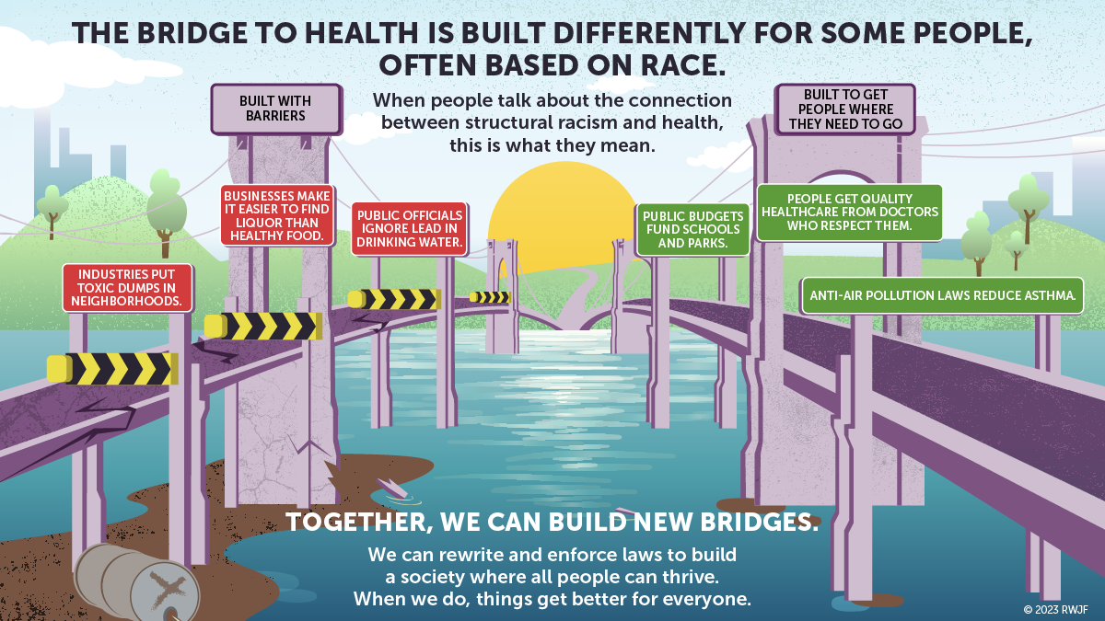

Slide 48


Current System: The Imbalance of Power
Health
Sciences and Knowledge System
Underdeveloped strength of community knowledge and social conception of health and wellbeing
Over-dominant paradigm of health defined by medical science and academia

Slide 49
RWJF Research Grantees are Focused on:
Examining some fundamental assumptions in our fields around science and power gradient
Going beyond social determinants to also focus on structural factors like racism that marginalize groups and lead to unfair health inequities
Interrogating conventional approaches to clinical algorithms, data construction and methodology
Moving toward meaningful and actionable information to advance health equity and dismantling structural racism
Innovation in and broader use of community led and engaged knowledge building

Slide 50
Recent Call for Proposals
Indigenous-Led Solutions to Advance Health Equity and Wellbeing
Systems and Services Research to Address Systemic Racism
Policy Research to Advance the Inclusion of Immigrant Families and Children
Innovative Research to Advance Racial Equity
Health Eating Research (currently open)

Slide 51
What We are Looking for
Expand our knowledge on how to dismantle structural racism within our generational goals
    Economic Inclusion for Family Wellbeing: Helping families thrive and expanding public support for the health and well-being of families and children.
    Equitable & Accountable Public Health & Healthcare Systems: RWJF is working towards advancing public health and creating more inclusive, equitable, and accountable public health systems.
    Health & Equitable Community Conditions: RWJF continues to provide community resources so individuals have a fair opportunity to reach their full health potential.
Research that is action oriented
Research that shifts the power in the current system
Research that includes community partnership

Slide 52
Where to look for RWJF funding opportunities
Look for opportunities for funding on www.rwjf.org
Subscribe to our list serve
Follow us on social media

Slide 53
PCORI – Funding Opportunities in Patient Centered Research
Steven Clauser, PhD, MPA
Director, Systems Comparative Clinical Effectiveness Research
Healthcare Systems Research Network, Annual Meeting, Milwaukee, WI April 11, 2024

Slide 54

Patient-Centered Outcomes Research Institute
Leading funder of patient-centered comparative clinical effectiveness research (CER)
Independent, nonprofit, research institute
Funds research designed to help people make better informed healthcare decisions
Notes:
Let’s begin with, who is PCORI and what PCORI does?
PCORI is an independent, nonprofit research organization authorized by Congress in 2010 (and reauthorized in 2019!) that seeks to empower patients and others with actionable information about their health and healthcare choices. We are governed by a 23-member BoG representing the entire healthcare community.
We fund comparative clinical effectiveness research or CER, which compares two or more medical treatments, services, or health practices. The findings from these studies help patients and other stakeholders make better informed decisions.
The vast majority of the research PCORI funds is for CER projects, but we also fund awards to promote engagement in research, dissemination and implementation projects, methodology research, and the development of research infrastructure, including PCORnet®, the National Patient-Centered Clinical Research Network. We issue PCORI Funding Announcements several times each year.

Slide 55

Key Features of PCORI-funded Research
Engages patients and stakeholders throughout research process
Compares at least 2 health treatments, services or care practices currently used
Focuses on questions most important to patients and those caring for them
Aims to produce evidence that can be applied in practice settings
Notes:
Key features of our funded research and research-related projects
We engage patients and other stakeholders throughout the research process, and are committed to ensuring they have a seat at the table throughout the research process—helping to prioritize research topics, design and conduct the studies, and share the results.
We fund comparative clinical effectiveness research, which compares two or more medical treatments, services, or health practices to help patients and other stakeholders make better informed health and healthcare decisions.
Our funded work focuses on answering questions most important to patients and those who care for them. We believe patients deserve to know whether some approaches work better than others for certain populations, and caregivers, clinicians, and all of our stakeholders benefit from having better information about different care options. With health, information is power, and PCORI funds research that allows all patients to become more empowered decision makers.
Our funded work aims to produce evidence that can be applied in real-world practice settings – this is often not a focus within health research.

Slide 56
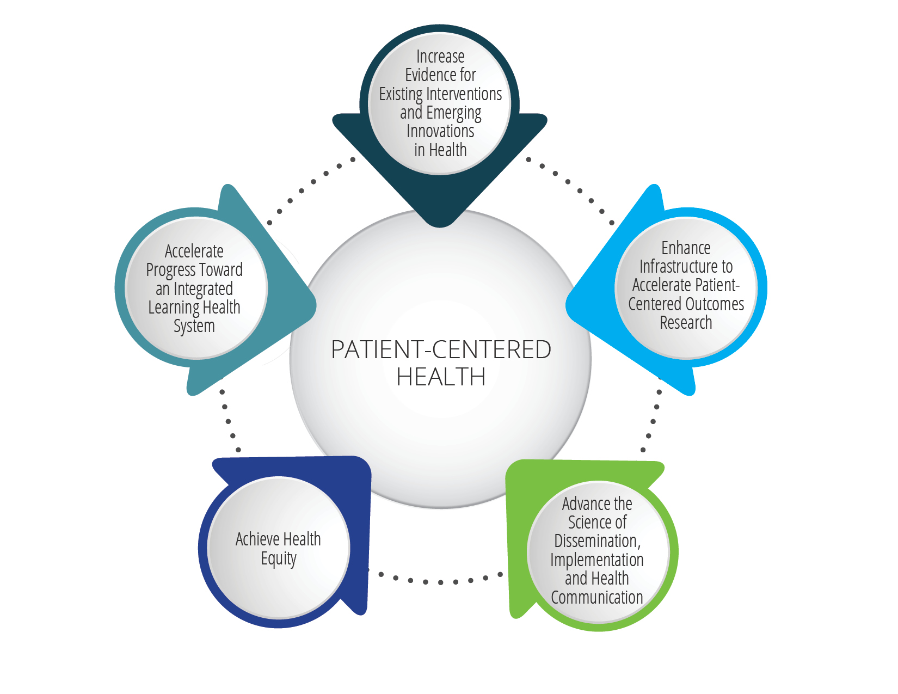
National Priorities for Health
Five ambitious long-term goals
Interconnected and mutually reinforcing
Purpose:
  Drive PCORI’s research funding and other initiatives
  Make a positive and significant impact on patient-centered care and health outcomes
Notes:
At the core of the Strategic Plan are five National Priorities for Health. These are ambitious, long-term goals that will guide PCORI’s funding of patient-centered CER and other initiatives related to engagement, dissemination and implementation, and research infrastructure.
Briefly, the adopted National Priorities for Health are:
Increase Evidence for Existing Interventions and Emerging Innovations in Health
Enhance Infrastructure to Accelerate Patient-Centered Outcomes Research
Advance the Science of Dissemination, Implementation, and Health Communication
Achieve Health Equity
Accelerate Progress Toward an Integrated Learning Health System
They are designed to work together in an integrated and synergistic way, revolving around the core goal of patient-centered health – and reinforced by the two cross-cutting themes of health equity and stakeholder engagement.
They are also focused intentionally on outcomes, through action verbs like advance and achieve, which reflects influences on health that are beyond the purely clinical realm.

Slide 57
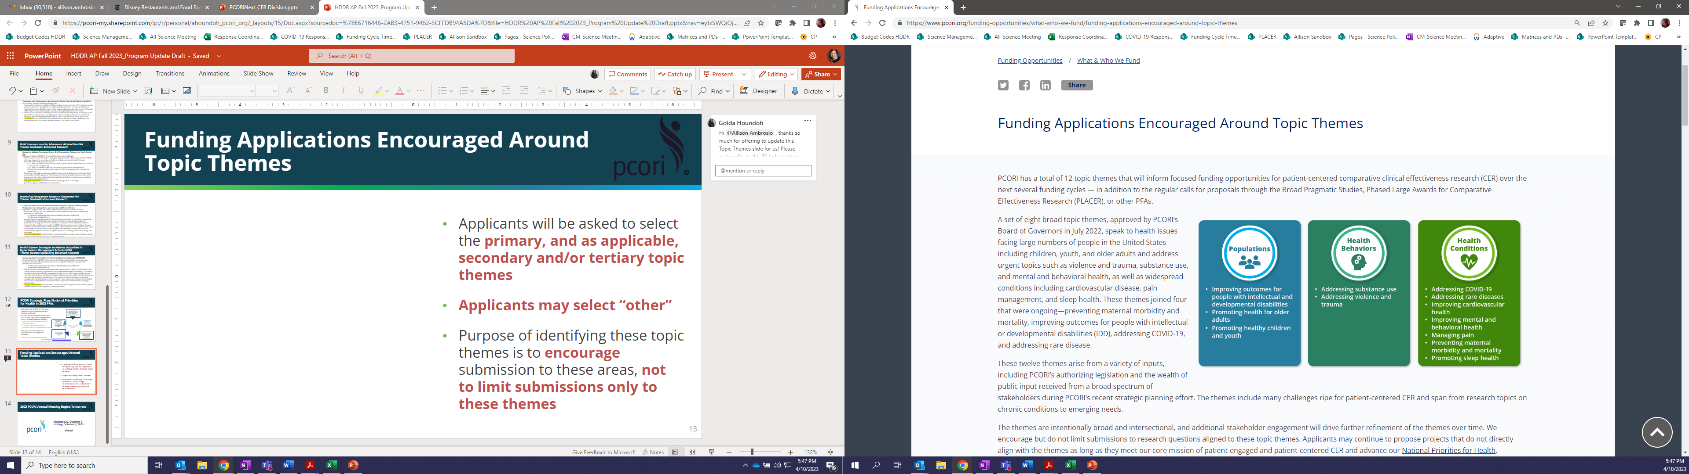
Topical funding announcements will guide near term funding in the next few years
Released Thematic PFAs:
Improving Cardiovascular Health
Promoting Sleep Health
Improving Outcomes for people with Intellectual and Developmental Disabilities
Promoting Health for Older Adults
Preventing Maternal Mortality and Morbidity
Promoting Sleep Health
Thematic PFAs to be Released:
Addressing Rare Diseases
Addressing Substance Use

Slide 58
Research Award Funding Opportunitites
Up to $5M
$5–12M
Broad Pragmatic Studies
Investigator-initiated awards in alignment with the National Priorities for Health
Three funding categories
Up to $750K
Methods
Improve use of AI and ML, Improve study design, Support data
research networks, Ethical and human subject protections in CER
2024
Funding Cycle LOI Deadlines
Cycle 1: Feb 6
Cycle 2: Jun 4
Cycle 3: Oct 1
Up to $1M
Up to$1.5M
Science of Engagement
Two funding categories: Rapid Measurement Studies
Development and testing of engagement techniques
Variable
Topical/Focused
Stakeholder-driven topics, issues, and questions of national significance
Up to $22M
for feasibility and
full-scale study
phases
Phased Large Awards for Comparative Effectiveness Research
Large, meritorious, and innovative studies with some risks
*All funds and timelines noted above are subject to change
Notes:
This slide gives you a snapshot of our typical suite of research award funding announcements that we offer throughout the year, multiple times a year, across 3 cycles.
Please note, there are other important funding opportunities that PCORI offers each cycle through different mechanisms including our Implementation funding opportunities and Engagement Award funding opportunities.
These will be addressed in breakouts and roundtables offered later today, which I highly encourage you to attend if interested.
Our funding announcements may either be "broad" calls for applications (for instance--Broad Pragmatic Studies, Methods, SoE, and PLACER)…or specific to certain topics (such as topical and targeted PFAs).
I would also like to call your attention to the blue box on the right side of this slide. These are the 2024 Funding Cycle LOI deadlines.
I encourage you to visit PCORI.org to review the detailed announcements and, if you have not already done so, to sign up for PCORI emails to receive notifications of funding opportunities.
I’m now going to delve a bit more deeply into each of these.

Slide 59
Key Award Management Facts
PCORI issues milestone-driven contracts rather than grants
  Compliance with Legislative Mandate requires strong accountability
Contracts:
  Are more specific than grants
  Have deliverables that must be established and met (milestones)
  Have significant funder involvement
Awards are issued to institutions via the Administrative Official (AO) who is required to sign-off on and submit all formal award-related communications
Notes:
And now for some key award management facts
PCORI funds comparative clinical effectiveness research through contracts rather than grant awards.
Once awarded, PCORI works with the applicant to execute a contract.
It’s important to note here that awards are issued to institutions via the Administrative Official—or AO—who is required to sign off on and submit all formal award-related communications.​
Of course, the PI is involved throughout the whole of the process
You may be asking--why Contracts? Well--PCORI research award contracts are milestone- and deliverable-driven, and payment is strictly tied to expenses related to successful performance and achievement of contract milestones and deliverables.
In other words, contracts are more specific than grants, have deliverables that must be established during contract negotiation and met throughout the course of the study, and have significant funder involvement

Slide 60
PCORI Methodology Standards
Research funded by PCORI must adhere to the PCORI Methodology Standards, which represent minimal requirements for the design, conduct, analysis, and reporting of patient-centered outcomes research
The 65 standards can be grouped into 2 broad categories and 16 topic areas.
  Cross-Cutting Standards
Formulating Research Questions
Patient Centeredness
Data Integrity & Rigorous Analyses
Preventing/Handling Missing Data
Heterogeneity of Treatment Effects
Design-Specific Standards
Data Registries
Data Networks
Causal Inference Methods*
Adaptive & Bayesian Trial Designs
Studies of Medical Tests
Systematic Reviews
Research Designs Using Clusters
Studies of Complex Interventions
Qualitative Methods
Mixed Methods Research
Individual Participant-Level Data Meta-Analysis (IPD-MA)
* The first standard for Causal Inference Methods (CI-1) is considered cross-cutting and applicable to all PCOR/CER studies.
Notes:
PCORI’s Methodology Standards provide minimal requirements for the conduct of scientifically valid patient-centered comparative effectiveness research. Reviewing these standards will be most helpful during the application phase, but we want to encourage you to look over them as you develop your letter of intent.
There are five cross-cutting standards that are considered relevant to most CER studies and those are in the left column. Please note, the Methodology Standards do not address all issues related to study design and methods, but are the considered the minimum standards for our research.
More information about each of the methodology standards can be found on our website.
PCORI staff assesses adherence to these standards prior to award and continue to monitor adherence over the course of the award. Methodology standards will be highlighted in your protocol and in interim progress reports.

Slide 61
Research Designs of Interest
Randomized Controlled Trials
Well-Designed Observational Studies
Hybrid Designs
  Hybrid type 1 and type 2 appropriate for all four National Priorities for Health
    One of the priority aims must be CER
  Hybrid type 3 designs focusing on implementation are only considered responsive in certain circumstances, depending on funding opportunity
Natural Experiments
  Rigorously designed studies assessing impact of naturally occurring interventions related to policies, systems-level strategies, and community partnerships may be appropriate
Notes:
We are interested in funding applications with rigorous study designs such as randomized controlled trials and well-designed observational studies.
In addition, combined clinical effectiveness and implementation trials using hybrid study designs may be proposed to assist in the translation of research findings into routine practice.
If such hybrid designs are used, one of the primary aims must focus on a comparative clinical effectiveness research question.
As such, hybrid type 1 and hybrid type 2 trial designs are responsive to all four National Priorities for Health noted in this PFA.
Do note, hybrid type 3 designs focusing on implementation will be considered responsive only for applications primarily addressing the National Priorities for Health goal: Advance the Science of Dissemination, Implementation, and Health Communication.
Finally, we are also interested in rigorously designed natural experiments comparing policies, systems-level strategies or community partnerships.
Consistent with PCORI’s authorizing law, PCORI does not fund research for which findings will include the following:
Coverage recommendations
Payment or policy recommendations
Creation of clinical practice guidelines or clinical pathways
Establishment of efficacy for a new clinical strategy
Pharmacodynamics
Study of the natural history of disease
Basic science or the study of biological mechanisms

Slide 62
Comparative Clinical Effectiveness Research
CER Portfolio 2020-present
$1803M
# projects actively managed
$million contracts managed

Slide 63
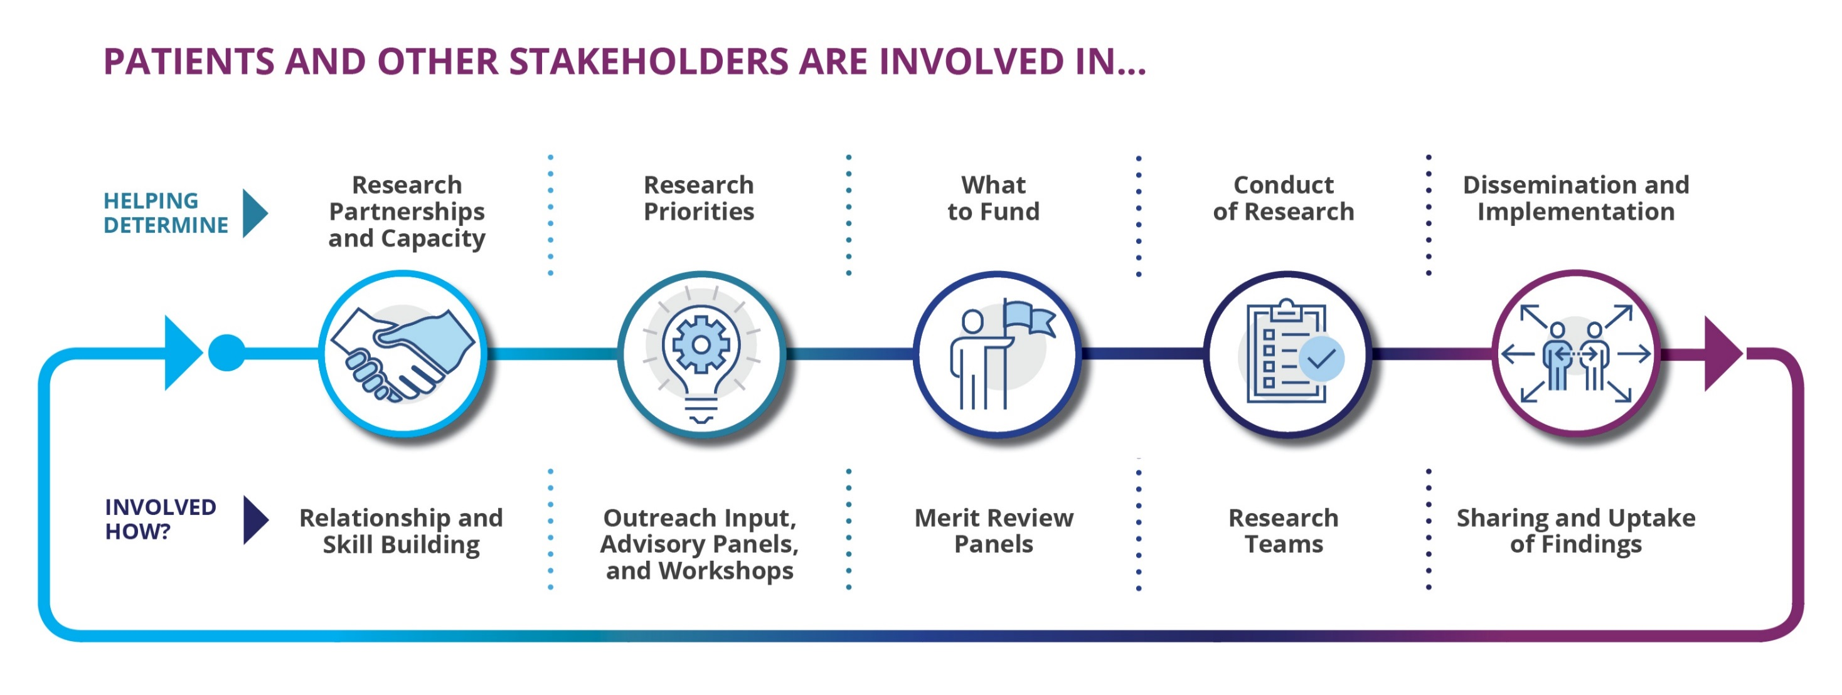

Where We Engage Partners:
Engagement in Research
Notes:
Now, I’d like to step back and look at the research funding process from a wider perspective.
What really makes PCORI unique is that we truly are stakeholder driven.
We seek the input of those stakeholders – patients, providers, caregivers, payers, employers, and policymakers – throughout our processes, from topic prioritization, generating the research question, conducting the study, to disseminating and implementing the results.
That input means we get a more meaningful question at the outset and increased likelihood that the results will be useful.
Balancing perspectives of stakeholders is done thru meaningful engagement, and meaningful engagement leads to better health outcomes.
BROADS ARE STILL PI DRIVEN
The MS Case Study:
A perfect example of how stakeholders drive our research portfolio is in the case of Multiple Sclerosis.
This is a situation where a number of new drugs (14) had come to market to treat patients with MS. But patients, providers, payers, all raised the need for more evidence to actually help them figure out which one worked best for certain populations and under what circumstances.
So we convened several workshops with each individual stakeholder before bringing them all together to make sure that whatever we funded had the input of all stakeholders and would actually be impactful for them.
And we now have several large studies on MS that will help patients decide how best to manage their care.
NOTE HERE WE HAVE SPECIFIC PROGRAMS TO SUPPORT THESE ACTIVITIES
PPE, EA, , ETC.

Slide 64
Eugene Washington PCORI
Engagement Award Program
Engagement Award: Capacity Building
Support projects that help communities increase their ability
to participate across all phases of PCOR/CER
Engagement Award: Dissemination Initiative
Support projects to help communities and organizations plan for or actively bring
pertinent PCORI-funded research findings to their specific audiences
Engagement Award: Stakeholder Convening Support
Convene stakeholders to explore critical issues related to PCOR/CER
and/or communicate PCORI-funded research findings to targeted end users
$300,000
Up to 2 years
$300,000
Up to 2 years
$100,000
Up to 1 year
Notes:
PCORI believes meaningful stakeholder engagement is a critical building block for relevant patient-centered outcomes research.
The Engagement Award Program provides funding to organizations around the country to build a community of patients and other stakeholders who are equipped to be partners in PCOR/CER.
Our program not only builds capacity for patients, caregivers, clinicians and other stakeholders to be genuine partners in research, but also supports the dissemination of results back to communities in tailored ways that resonate and speak directly to the stakeholders. This program can be a good entry point for some in the broader community who are not familiar with PCORI and our work.
Please note that the Engagement Award Program is not a research funding opportunity. Our program does not fund research studies.
This Engagement Award Program funding cycle includes the following funding opportunities. Please visit PCORI’s Funding Center for the full funding announcements.

Slide 65
HCSRN has strong record of PCORI funding
PCORI has awarded studies to the following HCSRN members:
Advocate Aurora Health
Baylor Scott & White Research Institute
Geisinger Health
Harvard Pilgrim Health Care Institute
HealthPartners Institute
Henry Ford Health
Kaiser Permanente (multiple plans)
Kaiser Foundation Research Institute
51 Studies Funded
6 Dissemination and Implementation Awards
15 Engagement Awards
28 Clinical Comparative Effectiveness Research Awards
2 Infrastructure Awards
$115 million of funding
$90 million in funding for Comparative Clinical Effectiveness Research
Notes:
HCSRN member organizations have a strong record of receiving PCORI funding.
In total, HCSRN member organizations have received over 115 million dollars of funding across 51 different projects. These projects have spanned all the funding opportunities we’ve discussed.
If you’re interested in a PCORI funding announcement, your colleagues in this room are incredible resources who have demonstrated success in receiving funding.

Slide 66
Thank you!
Steve Clauser, Director, Systems Comparative Clinical Effectiveness Research
202-827-7700
sclauser@pcori.org

Slide 67
Welcome to the
2024 Health Care Systems Research Network Conference
April 9-11, 2024
Milwaukee, WI

Slide 68
Poster Session I Winner
Jana Hirschtick, PhD, MPH
Research Scientist
Advocate Aurora Research Institute
Estimating Underdiagnosis Using the Electronic Health Record: A Long COVID Case Study

Slide 69
Poster Session II Winner
Amandeep Mann-Grewal, MPH
Statistical Analyst
Sutter Health Research Center For Health Systems Research
Self-Reported Survey Results about Experience of Virtual Reality Headset on Reducing Anxiety in Pediatric Urgent Care Clinic

Slide 70

Advancing High Quality, Equitable Research
in the Age of New
Health Care Technologies

Slide 71
Lunch will not be Provided
Thursday, April 11

Slide 72
Make Your Voice Heard.
Complete the Conference Evaluation
via the Emailed Link!

Slide 73

Thank You For Your Support

Slide 74
Advancing High Quality, Equitable Research
in the Age of New
Health Care Technologies

