Slide 1
Engagement in Research: Foundational Expectations for Partnerships
Kristin L. Carman, PhD, MA
Director of Public and Patient Engagement, PCORI
Mabel Crescioni, DrPH, JD, LLM
Senior Engagement Officer, PCORI
April 10, 2024

Slide 2
Panelists (and Involvement with PCORI)
moderator Kristin L. Carman, M.A., Ph.D., Director, Public and Patient Engagement (PPE), PCORI
Mabel Crescioni, DrPH, J.D., Senior Engagement Officer, PPE, PCORI
Kimberly Haugstad, MBA, CEO, Upequity
Current PCORI: Member of Rare Disease Advisory Panel; Prior: Executive sponsor for two PCORI projects while CEO at the Hemophilia Federation of America (HFA)
Karen E. Kippen, MSA, MT(ASCP), Executive Director, Patient-Engaged Research Center (ret.), Henry Ford Health
Current: Member PCORI Ambassador Program; Science of Engagement Research Award; Prior: PCOR Translation Center Abstract Reviewer; two Engagement Award Projects and two Pipeline to Proposal Awards

Slide 3
Panelists (and Involvement with PCORI) - contd
Karen Margolis, M.D., MPH, Senior Investigator, HealthPartners Institute
Current: Consultant to a currently funded project; Prior: Participated in two PCORI-funded studies (one as PI, one as Co-I) and served as DSMB member for several PCORI-funded projects.
Ellen Schultz, M.S., Owner / Principal, Ellen Schultz Consulting
Prior: Stakeholder reviewer for PCORI Science of Engagement awards (Spring/Summer 2023); Member of Project Advisory Group for a PCORI-funded project: Measuring What Matters for Advancing the Science and Practice of Engagement (2021 – 2022); Subject matter expert and quality assurance reviewer within PCORI’s Translation Center (2019-2021).

Slide 4
Goals For Today
Share context for PCORI as a funder and the role of engagement
Summarize the background and rationale for the Foundational Expectations for Partnership
Share PCORI‘s Foundational Expectations for Partnerships
Revised definition of engagement
Expectations & Examples in Practice

Slide 5
Background: PCORI’s Mission
PCORI helps people make informed healthcare decisions, and improves healthcare delivery and outcomes, by producing and promoting high-integrity, evidence-based information that comes from research guided by patients, caregivers, and the broader healthcare community.
How is PCORI Research Different?
We aim to produce evidence that can be easily applied in real-world settings​
We focus on answering questions most important to patients and those who care for them​
We engage patients, caregivers, clinicians, insurers, employers, and other stakeholders throughout the research process

Slide 6
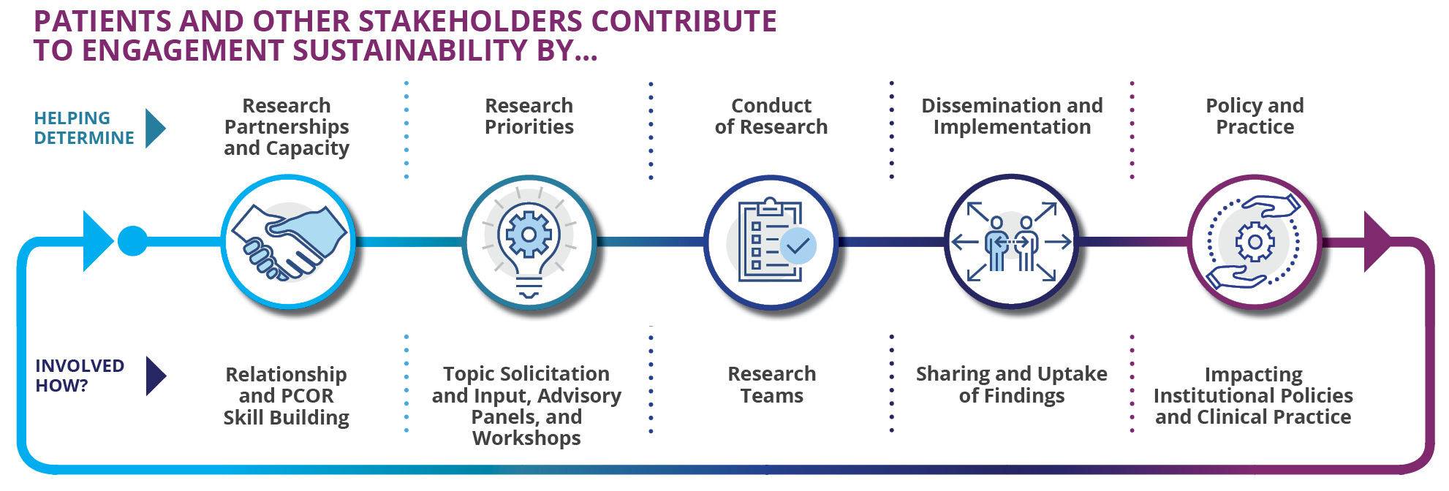
Background: Engagement as a Path to Useful, Patient-Centered and High-Quality Research
Research
Partnerships and Capacity
Research Priorities
Funding and Conduct of Research
Dissemination and Implementation
Policy and Practice
PCOR Skill Building and Infrastructure Development
Topic Solicitation, Advisory Panels
Merit Review, Research
Teams
Peer Review, Knowledge Sharing, and Uptake of Findings
Impacting Institutional Policies and Clinical Practice

Slide 7
PCORI's findings about engagement in Patient-Centered CER
Engagement improves study feasibility, acceptability and quality as well as the relevance of findings
Researchers have a better understanding of patients’ lives and of clinical processes and are committed to continuing engagement
Patients and other partners benefit from developing skills, contributing in a positive way and improving their own health
With meaningful inclusion in decision making throughout the study, researchers and partners build trusting relationships that can benefit communities, community organizations and academic institutions
See the Foundational Expectations for Partnerships (PDF) for citations: https://www.pcori.org/sites/default/files/PCORI-Engagement-in-Research-Foundational-Expectations-for-Partnerships.pdf

Slide 8
PCORI’s Foundational Expectations for Partnerships
Notes:
MC

Slide 9
Why did PCORI update the Engagement Guidance?
To build on a growing body of evidence about engagement to support meaningful, effective, and sustainable engagement with patients, communities, and other partners in research
To support achieving health equity – one of PCORI’s National Priorities for Health
Generate new knowledge
Enhance PCORI’s approach to Engagement
Foundational Expectations for Partnerships
Influencing the Field
Develop products to drive improved practice
Notes:
MC

Slide 10
Engagement in Research: Foundational Expectations for Partnerships
PCORI has developed six foundational expectations—building blocks for meaningful, effective, and sustainable engagement with patients, communities, and other partners in research. Researchers and partners should address each of these expectations when:
Applying for PCORI funding
Developing a project plan and engagement plan for awarded projects.
Reflecting on engagement during a project to improve and strengthen engagement over time.
Notes:
MC
PCORI’s updated Engagement Guidance: Engagement in Research: Foundational Expectations for Partnerships
Reflects findings from a collaborative and inclusive process:
Practice-based evidence generated from PCORI-funded patient-centered CER studies about the benefits and challenges of engagement
Collaboration with the Advisory Panel on Patient Engagement, including meetings to identify, prioritize and review expectations
A convening with 46 diverse attendees, including awardees, patient and other partners, funders and thought leaders
A review of existing guidance related to engagement in research as well as PCORI evidence and resources on engagement
Focus groups with 16 PCORI awardees and 17 patient partners
Interviews with 24 people with expertise in engagement and diversity, equity and inclusion

Slide 11
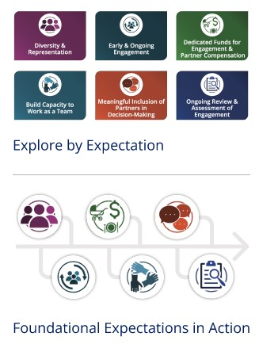
Engagement in Research: Foundational Expectations for Partnerships (cont.)
Definition of meaningful engagement (Updated)
Definition of patient partners and other partners
Foundational Expectations (New)
Overview (PDF)
Guidance to put the Foundational Expectations into practice (online)
Both the Overview and Guidance are available at:
Engagement in Research: PCORI's Foundational Expectations for Partnerships | PCORI
Notes:
MC

Slide 12
Meaningful Engagement (Updated)
An active partnership between researchers, patients, caregivers, clinicians and other partners throughout the entire research process — from planning the study to conducting the study and disseminating study results.
Engagement occurs along a continuum from providing input to consultation to collaboration and shared leadership. For PCORI, engagement practices limited to activities that only request input, such as conducting surveys and focus groups, are not considered meaningful engagement.
Notes:
MC

Slide 13
Foundational Expectations for Partnerships
Add new graphic
Notes:
MC

Slide 14
Foundational Expectations for Partnerships
Diversity & Representation | Projects should include partners, organizations, researchers and other team members who reflect the diversity of patients and communities affected by the research topic.
Early & Ongoing Engagement | Projects should ensure partners contribute early and throughout the study, including planning the study, conducting the study and disseminating study results.
Dedicated Funds for Engagement & Partner Compensation | Projects should dedicate funds to support engaging with partners and compensate partners for their time, expertise and perspectives in a timely manner and in ways that reflect their preferences and roles
Build Capacity to Work as a Team | Projects should identify skills, strengths and barriers to engagement and provide all team members with the information, training and support they need to work as a team.
Meaningful Inclusion of Partners in Decision Making | Projects should use engagement structures and processes that include partners in decision making throughout all phases of the project, with consideration of the project’s goals, scope and scale.
Ongoing Review and Assessment of Engagement | Projects should gather input and feedback throughout the project to identify what is working well and what could be improved, and then adjust engagement approaches as needed.
Notes:
MC

Slide 15
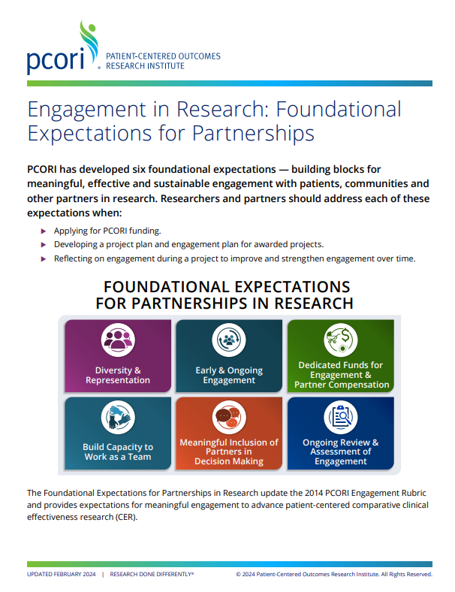
Share the Foundational Expectations with your community!
Questions about the Foundational Expectations?
Email us at engagement_questions@pcori.org
Notes:
MC

Slide 16
Appendix

Slide 17
Expectation: Diversity and Representation
Diversity & Representation
Projects should include partners, organizations, researchers and other team members who reflect the diversity of patients and communities affected by the research topic.
This expectation helps projects to:
Make sure the research is relevant to and addresses the needs of those most affected by the research topic.
Center patient and other partner perspectives in project decisions.
Avoid including only one patient or asking one partner to speak for all patients or communities historically excluded from research.
Notes:
Questions to ask when addressing this expectation:
How well do the partners and researchers on the team reflect the groups and communities that the project will benefit?
What efforts have been made to intentionally include a diverse range of partners and organizations, including those whose perspectives and experiences have been historically excluded from research?
To what extent does the team include patients with lived experience related to the research topic as partners versus asking researchers or other team members to describe the patient perspective? Typo corrected

Slide 18
Expectation: Early & Ongoing Engagement
Early & Ongoing Engagement
Projects should ensure partners contribute early and throughout the study, including planning the study, conducting the study and disseminating study results.
This expectation helps projects to:
Ensure that every phase of the project benefits from partners’ contributions.
Meet project goals and outcomes.
Assign roles and activities based on partner preferences, skills, strengths, and life circumstances.
Build on community strengths and assets.
Notes:
Questions to ask when addressing this expectation:
How will partners contribute to all phases of the project?
How have partners and communities been engaged to develop the research topic, questions, approach and outcomes so that it addresses their priorities, needs and experiences?
How have partners helped develop the Engagement Planengagement strategy , including defining their roles and responsibilities? How will partners be involved in refining their role as needed during the project?
To what extent do partners’ roles and responsibilities reflect their skills, strengths, interests and preferences? Edited to remove the term “Engagement Plan” per Engagement team

Slide 19
Expectation: Dedicated Funds for Engagement & Partner Compensation
Dedicated Funds for Engagement & Partner Compensation
Projects should dedicate funds to support engaging with partners and compensate partners for their time, expertise and perspectives in a timely manner and in ways that reflect their preferences and roles
This expectation helps projects to:
Compensate partners in ways that reflect their needs and preferences, both financially and non-financially, while avoiding unintended consequences like loss of public benefits.
Support meaningful engagement of partners in all phases of the project.
Notes:
Questions to ask when addressing this expectation:
To what extent does the project budget compensate partners at an amount that reflects their expertise, role and contributions? To what extent is compensation equitable among partners?
To what extent have partners been involved in determining the type, amount and frequency of compensation?
To what extent does compensation account for out- of-pocket costs that may be barriers to participation, such as parking, transportation or child care?
To what extent does the project budget include funds to support full partner participation such as an engagement coordinator, training, interpreters or technology supports, such as tablets or screen readers?

Slide 20
Expectation: Build Capacity to Work as a Team
Build Capacity to Work as a Team
Projects should identify skills, strengths and barriers to engagement and provide all team members with the information, training and support they need to work as a team.
This expectation helps projects to:
Meet project goals and outcomes by identifying potential challenges and building on team members’ strengths.
Address power imbalances between researchers, patients and other partners within the team and create team cohesion.
Improve productivity of all team members by ensuring all have the necessary information about the project topics, methods and activities to contribute effectively
Notes:
Questions to ask when addressing this expectation:
How will the team identify and build on partners’ skills and strengths?
How have barriers that affect team members’ participation been identified and discussed?
How can the team overcome barriers by offering supports or resources and building on partners’ skills and strengths?
To what extent are researchers ready to engage with patients and other partners? How will researchers develop and strengthen skills to engage with partners who bring different perspectives?
What information and supports will help partners contribute at different stages of the project? How will ongoing needs be identified and addressed to support participation?

Slide 21
Expectation: Meaningful Inclusion of Partners in Decision Making
Meaningful Inclusion of Partners in Decision Making
Projects should use engagement structures and processes that include partners in decision making throughout all phases of the project, with consideration of the project’s goals, scope and scale.
This expectation helps projects to:
Ensure partner perspectives influence decisions about study planning and conduct and dissemination of results.
Acknowledge and address power imbalances between researchers, patient partners and other partners.
Promote transparency about decision making and minimize conflicts that may arise among team members.
Promote meaningful engagement, shared leadership and shared responsibility.
Notes:
Questions to ask when addressing this expectation:
TBD – still a good amount of edits/comments in the doc on 1/2/2024 – pull in once finalized

Slide 22
Expectation: Ongoing Review & Assessment of Engagement
Ongoing Review and Assessment of Engagement
Projects should gather input and feedback throughout the project to identify what is working well and what could be improved, and then adjust engagement approaches as needed.
This expectation helps projects to:
Involve all team members in continuous learning to improve the process of engagement, including understanding whether engagement is occurring as intended, effectively and in an equitable manner.
Understand the impact of engagement on the project.
Notes:
Questions to ask when addressing this expectation:
At what points and how will teams gather input from all team members about the process and impact of engagement, including its effect on the project and team members’ relationships?
What processes are in place to ensure engagement- related issues and concerns are addressed respectfully in a timely manner and that partners are involved in the process?
What processes are in place to adjust existing engagement approaches based on assessments? How can these processes help strengthen partnerships and repair trust if needed?

Slide 23
PCORI’s 2014 Engagement Rubric

Slide 24
Engagement Resources
Engagement in Health Research Literature Explorer: https://www.pcori.org/engagement/engagement-literature
Measuring What Matters for Advancing the Science and Practice of Engagement: https://www.pcori.org/resources/measuring-what-matters-advancing-science-and-practice-engagement
Other resources: https://www.pcori.org/engagement/engagement-resources
Questions: Engagement_Questions@pcori.org

Slide 25
Research Fundamentals
New to Patient-Centered Outcomes Research?
Explore our Research Fundamentals
Free, self-paced, online training
Easy to understand modules
Helps people better understand the healthcare research process and to learn how to get involved in patient-centered CER
https://www.pcori.org/engagement/research-fundamentals
Scan Now
Notes:
People new to health research or patient-centered research have many questions:
What is patient-centered outcomes research? How does the research process work? How can I be an effective partner on a research study?
PCORI’s free on-demand training package, Research Fundamentals, answers those questions and more.
It is designed to help you understand the language and logic of the research process in an engaging and easy-to-grasp way.
To learn more, visit, PCORI dot org backslash research hyphen fundamentals.

Slide 26
Multi Stakeholder Research Teams
Tips for Building Effective Multi-Stakeholder Research Teams
Explore PCORI’s Free Resources for:
Establishing best practices
Defining roles and responsibilities
Making effective group decisions
Planning for collaboration
Sustaining engagement
And More!
https://research-teams.pcori.org/
Scan Now

Slide 27
Patient-Centered Outcomes Research Institute
Engagement Tools & Resources
Engagement Tool & Resource Repository
Searchable peer-to-peer repository
Explore 400+ engagement-related tools and resources developed and used by PCORI awardees
Includes toolkits, case studies, engagement guides, training manuals, white papers, tip sheets and more
Scan Now
Notes:
PCORI is committed to advancing patient-centered, stakeholder-engaged research and the meaningful involvement of patients, caregivers, clinicians, and other healthcare stakeholders throughout the entire research process.
We do this to ensure the results of the studies we fund are relevant, trustworthy, and more likely to be used in practice. PCORI also supports the uptake of engagement practices and methodologies within the broader healthcare research community.
To encourage the spread of these practices, we have assembled a repository of more than 400 engagement-related tools and resources developed and used by PCORI awardees.
This searchable peer-to-peer repository includes resources such as case studies, toolkits, training manuals, tip sheets and more aimed that can inform future work in PCOR and was developed based on a process.
To learn more, visit, PCORI dot org.

Slide 28
Engagement Resources on PCORI Website
PCORI Engagement Rubric​
Compensation Framework​
Equity & Inclusion Guiding Principles
Budgeting for Engagement Activities​
Engagement Plan (Updated Template)​
Engagement Tool and Resource Repository
Engagement in Health Research Literature Explorer
Find more at: pcori.org/engagement-resources

Slide 29
PCORI Engagement Resources
Engagement Trainings & Tools
Building Effective Multi-Stakeholder Research Teams
Research Fundamentals
Guide for Engaging with Research Partners about Data and Analysis
Engagement Tool and Resource Repository for Patient-Centered Outcomes Research
Engagement in Health Research Literature Explorer
Measuring What Matters for Advancing the Science and Practice of Engagement
Videos & Modules​
Creating Partnerships for Better Engagement​
Impact of Engaging Patients with Asthma as Partners in PCOR​
Engaging in Stakeholder Driven Research*​
The PCORI Approach to Patient-Centered Outcomes Research*​
* These modules are part of Research Fundamentals – the free online training created by PCORI for research partners who are new to the research process.
Questions: Engagement_Questions@pcori.org

Slide 30
Key Engagement Literature
Key Engagement Literature​
Maurer ME, et. al 2023. Examining how study teams manage different viewpoints and priorities in patient‐ centered outcomes research: results of an embedded multiple case study. Health Expect. 2023;1‐12. doi:10.1111/hex.13765​
PCORI, 2023. Measuring What Matters for Advancing the Science and Practice of Engagement​
Maurer ME, et. Al 2022. Understanding the Influence and Impact of Stakeholder Engagement in Patient-centered Outcomes Research: a Qualitative Study. J Gen Intern Med. ​
Heckert A, et. al 2020. Researchers, patients, and other stakeholders' perspectives on challenges to and strategies for engagement. Res Involvement Engagement.​
Forsythe, et al. 2019. Patient Engagement in Research: Early Findings from The Patient Centered Outcomes Research Institute. Health Affairs.​
Crocker, et al. 2018. Impact of patient and public involvement on enrollment and retention in clinical trials: systematic review and meta-analysis. BMJ.​
Boivin, et al. 2018. Evaluating patient and public involvement in research BMJ.​
Carman, et al. 2013. Patient and Family Engagement: A Framework for Understanding the Elements and Developing Interventions and Policies. Health Affairs.​

