Slide 1

Application DESIGN Using LUCIDCHART
Presentation By Jeremiah Litondo
Programmer - KPWHRI
09-10-2024

Slide 2




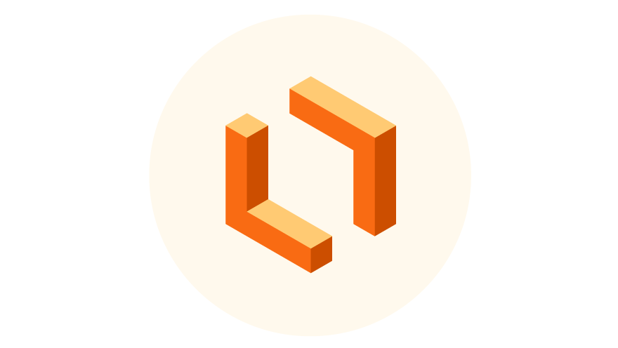
What is Lucidchart?
Lucidchart is a cloud-based software application that provides a platform through which teams can collaborate through its visual tools
Contains a wide array of tools that can be used for creating flowcharts, technical diagrams, presentations and User Interface mockups
Is accessible through any device with an internet connection
Created by a software company called Lucid, based in Utah.

Slide 3




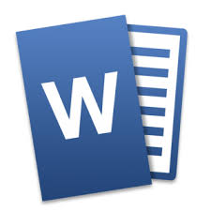
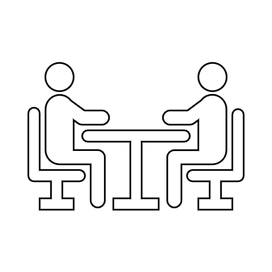
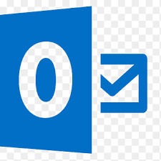

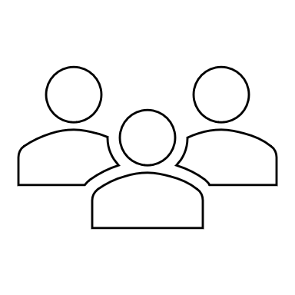
The Switch to lucid
Specifications
Development
Deliverables
Meeting
Misinterpretation
Confusion
Redesign
recode
Feedback

Slide 4

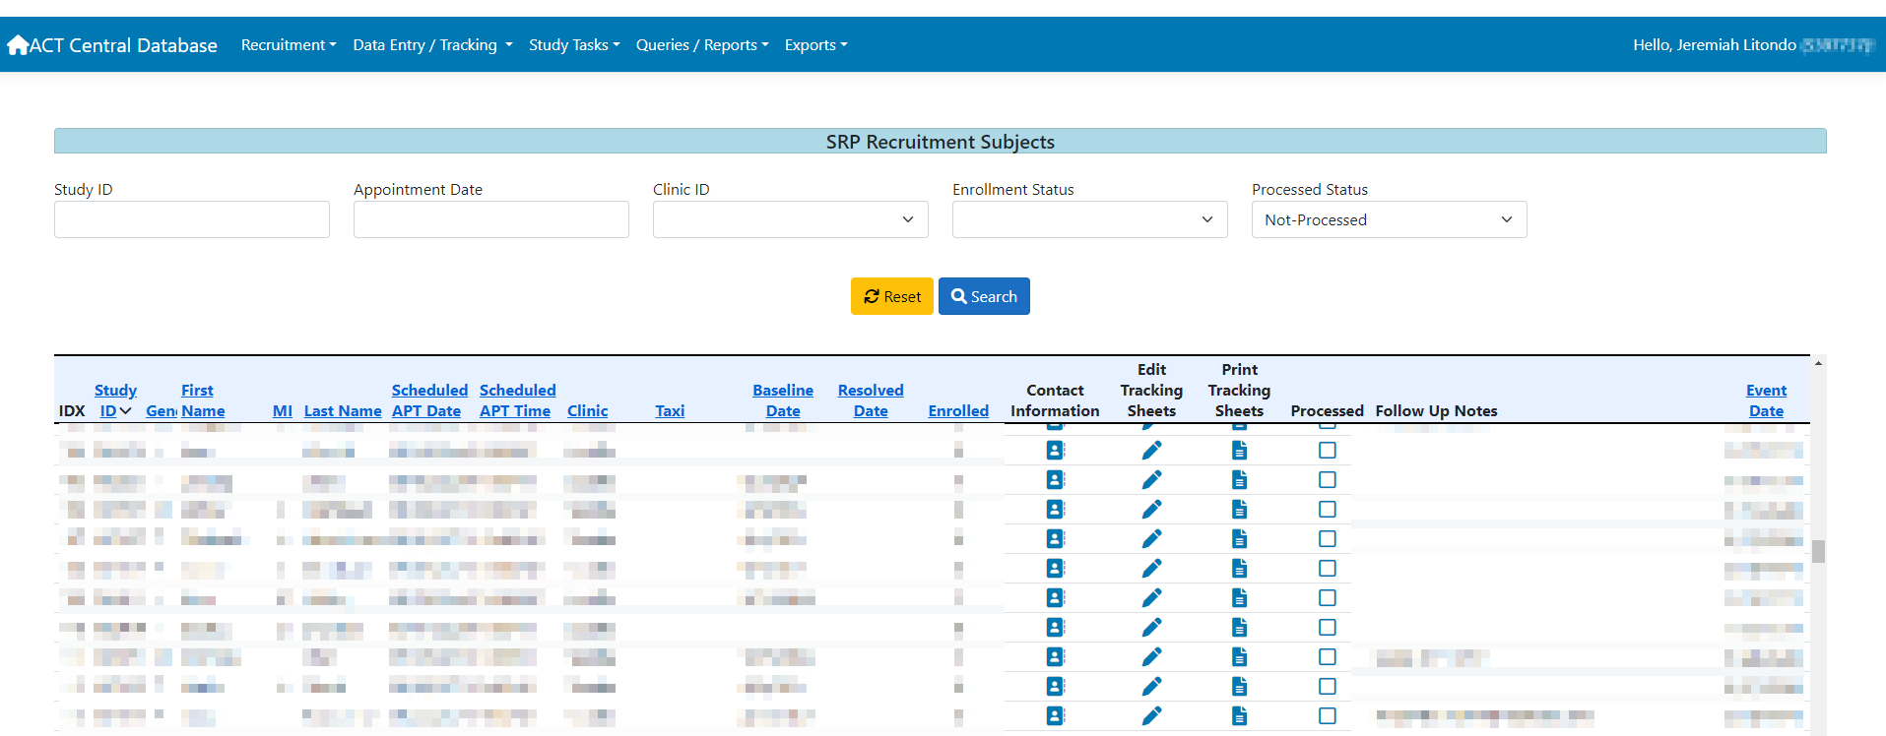
Sample - UI REQUEST (no phi)

Slide 5
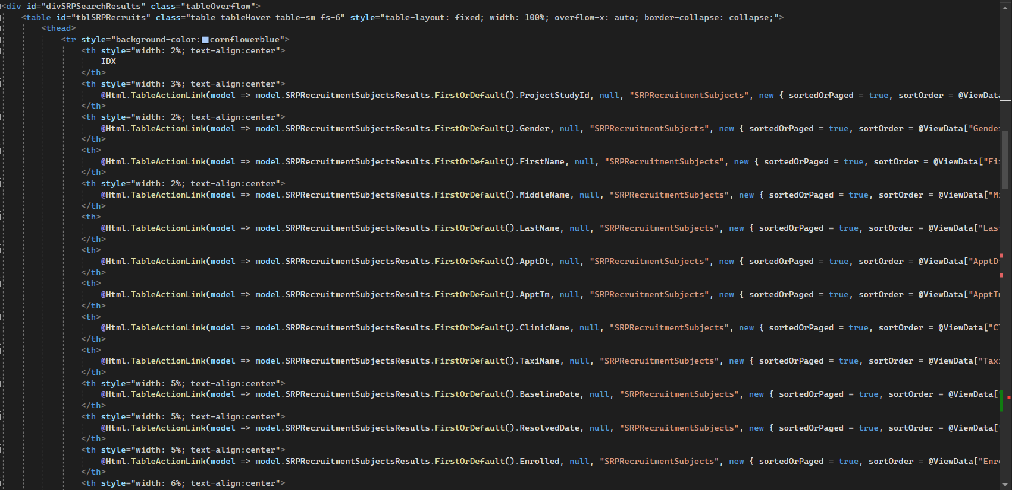
Sample - UI Design code

Slide 6

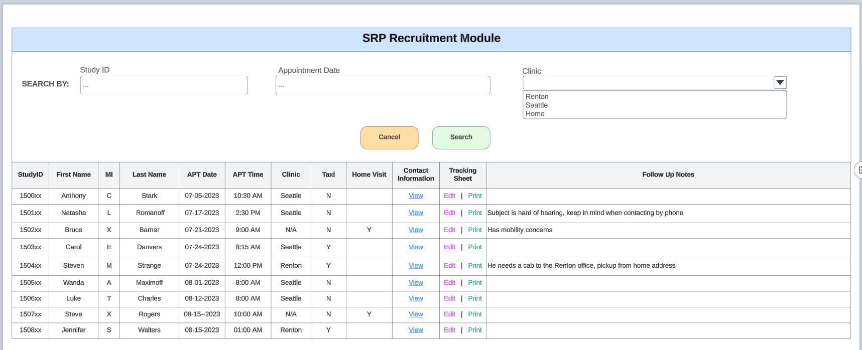
Sample – Lucid UI design

Slide 7

Lucid demo
Brief demo of LUCID

